Slide 1
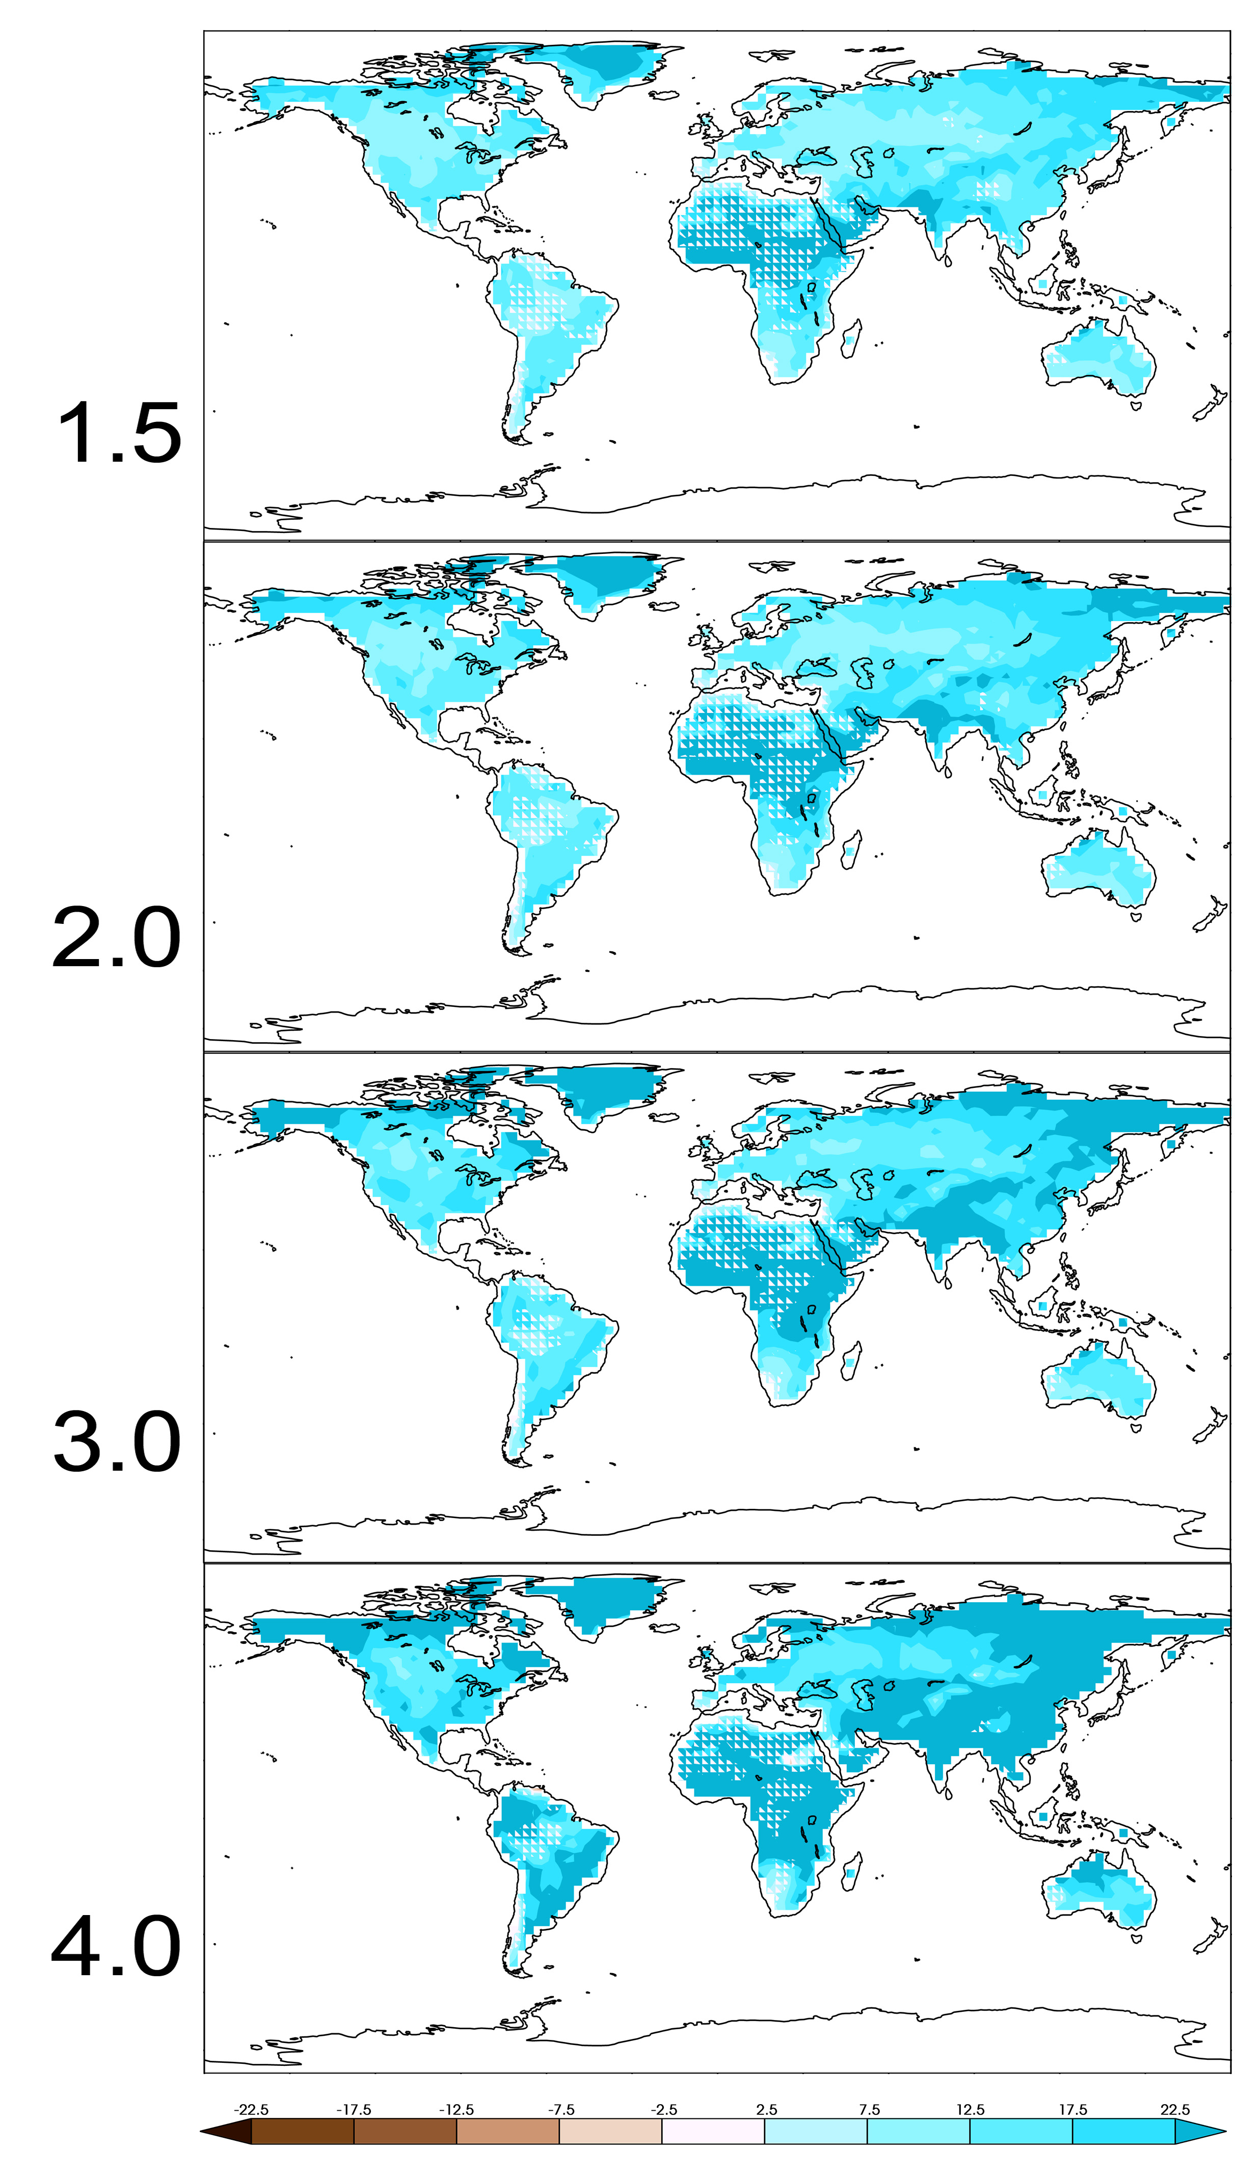

­­­­Characterization of long period return values of extreme daily temperature and precipitation in the CMIP6 models: Part 2, projections of future change.
Projections of changes in extreme daily temperature and precipitation from the CMIP5 and CMIP6 climate models are framed in terms of specified global warming target temperatures rather than at specific times and under specific emissions scenarios. At their standard resolutions, there are no meaningful differences between the two generations of models in their projections of simulated extreme daily temperature and precipitation at specified global warming targets at fixed global warming levels.
This is part 2 of a two part study, the other one evaluating simulated extreme temperature and precipitation of the recent past. Taken together, we conclude that the CMIP5 and CMIP6 models are indistinguishable in their simulated extreme temperature and precipitation, in large part because model resolution is unchanged.
Projected future changes in selected extreme daily temperature and precipitation indices the CMIP5 and CMIP6 climate models are calculated and compared at fixed global warming levels.
Michael Wehner (2020) Characterization of long period return values of extreme daily temperature and precipitation in the CMIP6 models: Part 2, projections of future change. To appear in Weather and Climate Extremes.
Figure: CMIP6 Multimodel average projected percent changes in 20 year return values of Rx1day (very wet days) at global warming levels of 1.5, 2, 3 and 4C above preindustrial values.

