Slide 1
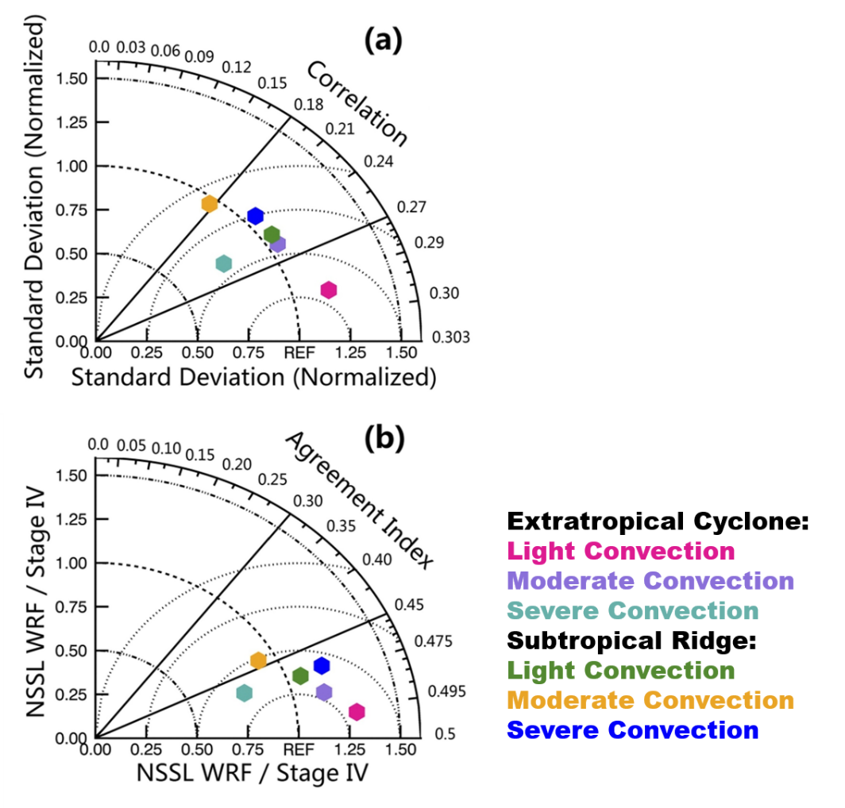
An Evaluation of Regional Climate Model Based on the Unsupervised Classification of Large Scale Patterns over the Great Plains
Objective
Examine the long-term performance of the Weather Research and Forecasting (WRF) model in simulating warm-season precipitation under different large scale patterns.
Approach
Construct a comprehensive subset of atmospheric variables from the reanalysis data to best represent the large scale conditions.
Apply the Self-Organizing Map (SOM) method to identify major large scale patterns
Quantitatively evaluate the WRF simulated precipitation under the two types of weather patterns.
Impact
Proved SOM is capable of separating the two major types of large scale weather.
Developed a database for six types of warm season Great Plain weather systems for model evaluation and weather forecasting with WRF.
Determined WRF best simulates warm sector precipitation under extratropical cyclone. It simulates convective precipitation at the periphery of a subtropical ridge the worst.
Demonstrated WRF simulates stratiform-dominated light convection events better than severe convection events.
The above Taylor diagrams compare the Weather Research and Forecasting (WRF) simulation to Stage IV observation for each self organizing map (SOM) class.
Wang, J., X. Dong, A. Kennedy, B. Hagenhoff, and B. Xi, 2019: A Regime-Based Evaluation of Southern and Northern Great Plains Warm-Season Precipitation Events in WRF. Wea. Forecasting, 34, 805–831, https://doi.org/10.1175/WAF-D-19-0025.1
Notes:
http://www.pnnl.gov/science/highlights/highlights.asp?division=749

