Slide 1
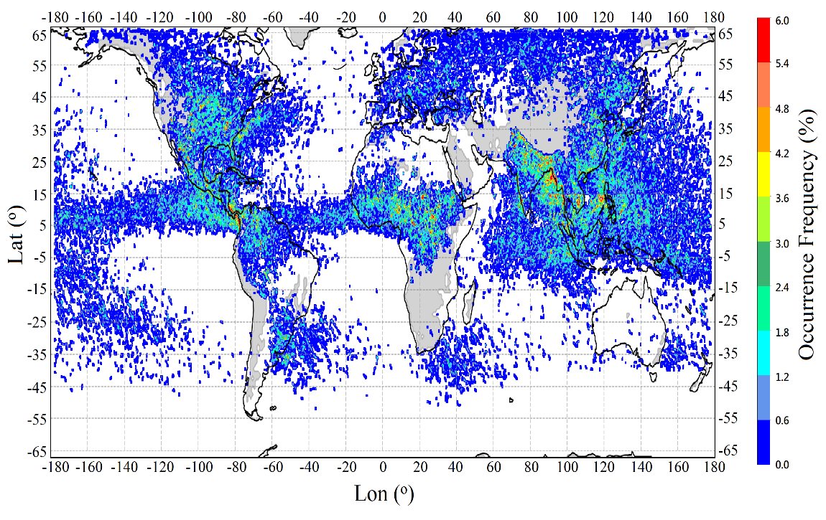
Global Detection of Mesoscale Convective Systems Based on GPM Ku-band Radar
Objective
Determine the detectability of mesoscale convective systems (MCSs) using the 3D radar reflectivity field observed by the Ku-band radar onboard the Global Precipitation Measurement (GPM) core satellite
Calculate and map the global distribution of MCSs.
Approach
Quantitatively compare the 3D radar reflectivity observed by the GPM to the densely distributed ground-based radar network over the United States
Validate the GPM capability of detecting MCSs with an MCS tracking dataset based on the multi-platform observational network
Apply the GPM-based detection method globally.
Impact
The majority of extreme storms observed by GPM were validated as MCSs
The global map of MCSs established by this study is a powerful dataset that can be used for studying and monitoring MCSs globally, especially over remote regions.
Researchers established, for the first time, a global map of MCS occurrence in regions beyond 30° latitude. The map revealed several MCS hot zones.
Wang, J., R. Houze, J. Fan, S. Brodzik, Z. Feng, and J. Hardin, 2019: The detection of mesoscale convective systems by the GPM Ku-band spaceborne radar. J. Meteor. Soc. Japan, 97, https://doi.org/10.2151/jmsj.2019-058
Notes:
http://www.pnnl.gov/science/highlights/highlights.asp?division=749

