Slide 1
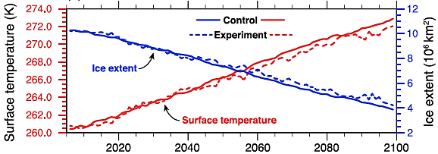
Climatic Responses to Future Trans-Arctic Shipping
Objective
Project how trans-Arctic shipping in an ice-free Arctic Ocean could affect the environment
Approach
Estimate shipping trends from the present to 2099 by taking into account transport of goods from ports in Europe and Asia through the Arctic
Calculate fuel needs, and estimate total emissions of sulfur, black carbon, and other particulates in a global Earth system model (CESM1) to simulate the net climatic effects of additional shipping emissions
Impact
With increased Arctic shipping traffic, cloud cover and liquid water content exhibited significant increases
Changes in clouds caused the Arctic surface air to cool nearly 1°C by the end of this century relative to the shipping‐free Arctic
This study illustrates the complexity of climatic responses to increased shipping in the Arctic
CESM1 simulated multidecadal trends in the Arctic surface temperature (red) and ice extent (blue). The Control (solid lines) is from an ensemble of fully coupled CESM simulations under the RCP8.5 emissions scenario (characterized by increasing concentrations of greenhouse gases through 2100). The Experiment (dashed lines) includes the additional trans-Arctic shipping emissions on top of the Control. The surface temperature is a little lower, and sea ice extent a little higher, when ship emissions are accounted for.
Stephenson SR, W Wang, CS Zender, H Wang, SJ Davis, and PJ Rasch. 2018. ”Climatic Responses to Future Trans‐Arctic Shipping.” Geophysical Research Letters 45(18):9898−9908. DOI: 10.1029/2018GL078969
Notes:
http://www.pnnl.gov/science/highlights/highlights.asp?division=749

