Slide 1
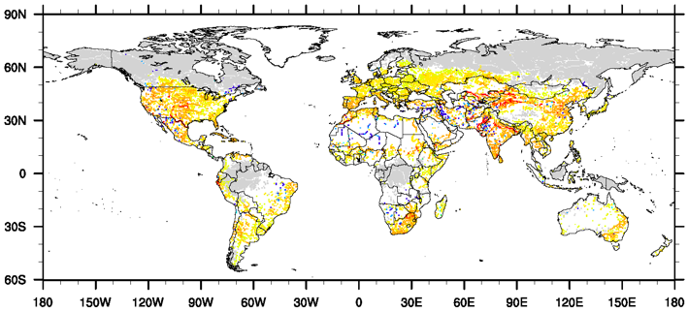
Effects of Water Management on Future Droughts: A Global Multi-Model Analysis
Objective
Investigate the effects of water management (agricultural irrigation, water withdrawal, and reservoir regulation) on future meteorological, agricultural, and hydrological droughts, and their interconnections.
Approach
Analyze simulations by four global hydrological models, driven by five global climate models under RCP2.6 and RCP8.5, with and without effects of water management.
Derive drought indices for meteorological, agricultural, and hydrological droughts.
Changes in future recurrence of historically 100-year natural hydrological droughts due to water management in 2070–2099 under the RCP8.5 scenario.
Impact
Water management activities reduce the duration and intensity of agricultural droughts, but increase those of hydrological droughts by up to 50%.
Water management can change the return period of extreme hydrological drought events under natural conditions from 100 years to 50 years or less.
Wan W, J Zhao, H Li, A Mishra, M Hejazi, H Lu, Y Demissie, and H Wang. 2018. “A Holistic View of Water Management Impacts on Future Droughts: A Global Multi-Model Analysis.” Journal of Geophysical Research: Atmospheres 123: 5947–5972. https://doi.org/10.1029/2017JD027825

