Slide 1
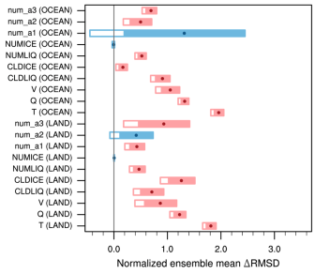
A New Method for Testing the Reproducibility of Atmosphere Model Results
Objective
Design a simple, objective, and computationally efficient regression testing method to assure an atmosphere model produces solutions of the same quality under circumstances when bit-for-bit identical results are no longer achievable.
Approach
Model results are considered “changed beyond noise level” when the time integration errors calculated against a benchmark are found to be inconsistent with previous verified values.
Very short integration length and the use of ensembles ensure low computational cost and fast turnaround.
The new test method successfully identifies a compiler configuration that was independently assessed to be problematic for the Community Atmosphere Model.
Impact
Objective and inexpensive regression tests are important for collaborative development of complex models to ensure the quality of the code and computing environment.
The new method is based on the generic concept of time step convergence and can be applied to other geophysical models.
Wan H, K Zhang, PJ Rasch, B Singh, X Chen, and J Edwards. 2017. “A New and Inexpensive Non-bit-for-bit Solution Reproducibility Test Based on Time Step Convergence (TSC1.0).” Geoscientific Model Development, 10:537-552. DOI:10.5194/gmd-10-537-2017
Notes:
http://www.pnnl.gov/science/highlights/highlights.asp?division=749

