Slide 1
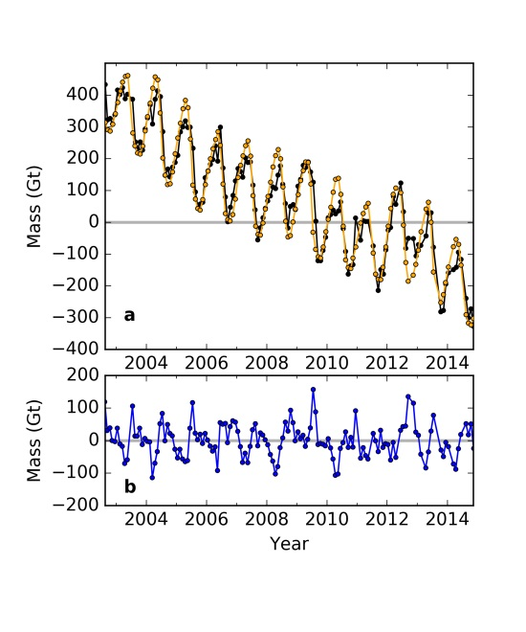
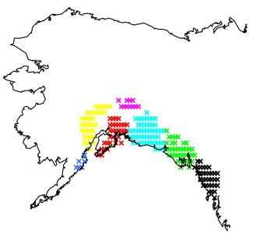
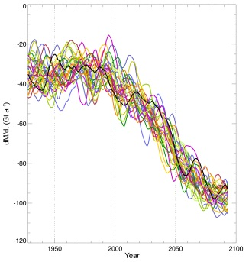
Using GRACE and Climate Model Simulations to Predict Mass Loss of Alaskan Glaciers Through 2100
Objective
Impact
Over the first decade of the twenty-first century, Alaskan glaciers contributed about 50 Gt/yr of global sea level rise (e.g. Jacob et al, 2012; Gardner et al, 2013), equivalent to ~60% of the contribution from Antarctica over that same time period (e.g. Shepherd, et al, 2012).
Thus, the relatively rapid response of mountain glacier systems to atmospheric warming implies that through 2100, contributions from glaciers are likely to be relatively important, and it is of interest to examine the evolution of Alaskan glaciers when trying to project sea level rise over the next century.
By applying the same three-parameter model to 30 simulations of atmospheric temperature and snowfall through 2100, we compute projections of mass loss from Alaskan glaciers. We adjust the parameter values as time progresses, by accounting for how the values of those parameters would change as the total glacier volume and area decrease. Our imperfect knowledge of how those parameters change is the source of greatest uncertainty in our final estimates of future glacier mass loss. We conclude that the total contribution to global sea level rise from Alaskan glaciers will be 19 ± 4 mm between 2001 and 2100. This corresponds to a total mass loss of about 7,000 Gt, which is nearly 50% of the present-day total Alaskan glacier mass.
Approach
Here we develop a simple, regional observation based prediction of Alaska’s future sea-level contribution. We compute a time series of recent Alaska glacier mass variability using monthly GRACE gravity fields from August, 2002 through December, 2014. We also construct a simple three-parameter model of Alaska mass variability based on monthly ERA-Interim snowfall and temperature fields. When these three model parameters are fit to the GRACE time series, the model can explain 94% of the variance of the GRACE data. We apply this this same simple model, with these same parameter values, to simulated fields of monthly temperature and snowfall from the Community Earth System Model, to obtain predictions of mass variations through 2100.
Top left:map of glacier location, right: comparison of GRACE data to model, bottom left: Alaskan glacier mass projections based on CESM LE.
Reference: Wahr, J., E. Burgess, and S. Swenson, Using GRACE and Climate Model Simulations to Predict Mass Loss of Alaskan
Glaciers Through 2100, J. Glaciology, accepted, 2016..

