Slide 1
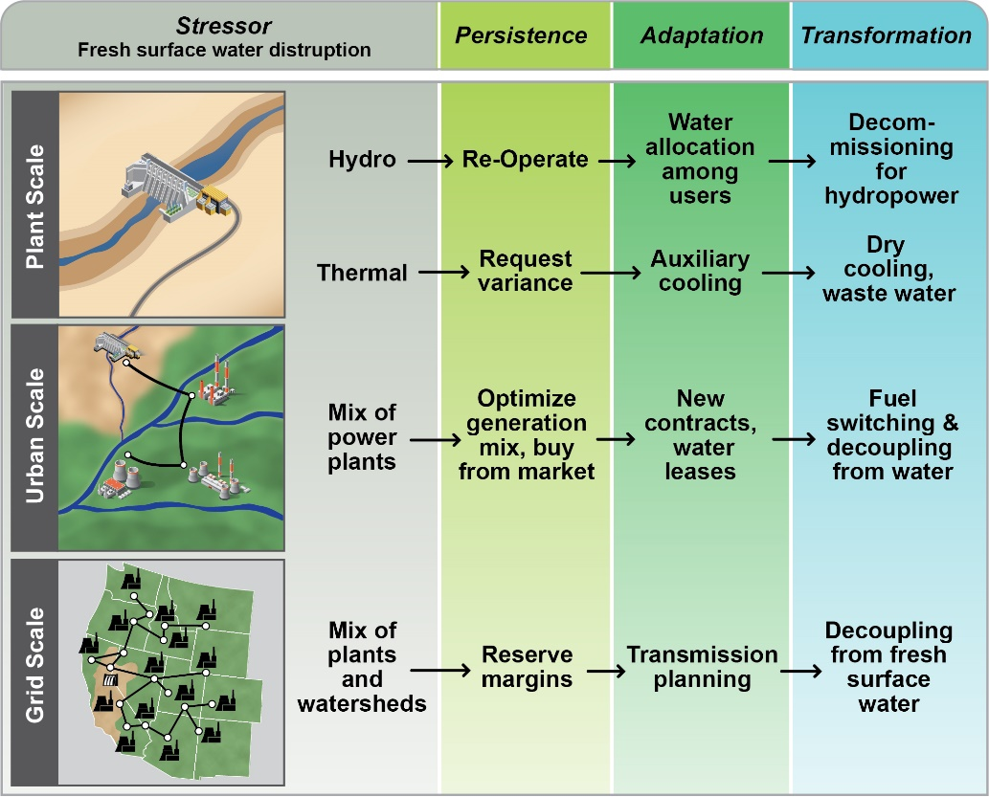
Identifying Water’s Scale-Specific Impacts on Resilient Electricity System Design
Objective
Identify how variations in water resource availability and infrastructure influence U.S. electricity system resilience, operations, and planning
Approach
Evaluate system resilience with three capabilities: persistence (normal operations); adaptability (contingency operations); and transformability (restructuring of operations and infrastructure)
Apply the electricity sector resilience framework across three scales of water-electricity interdependencies: power plant, utilities/urban, and grid
Impact
Developed the first multi-scale description of water-electricity resilience in the U.S.
Achieved better understanding of a complex system’s response at various scales, which provides guidance for joint water-electricity resilience and security
Initiated guidelines for future research exploring the complex system of systems resilience, stress response, and co-evolution opportunities
One plant, one river
Connected plants, connected watersheds, one climate region
Connected plants, disconnected river basins, multiple climate regions
Resilience evaluation framework applied to the electricity system in response to water stressors.
Voisin N, Tidwell V, Kintner-Meyer M, and Boltz F. 2019. “Planning for Sustained Water-Electricity Resilience over the U.S.: Persistence of Current Water-Electricity Operations and Long-Term Transformative Plans.” Water Security, 7:100035. DOI:10.1016/j.wasec.2019.100035
Notes:
http://www.pnnl.gov/science/highlights/highlights.asp?division=749

