Slide 1
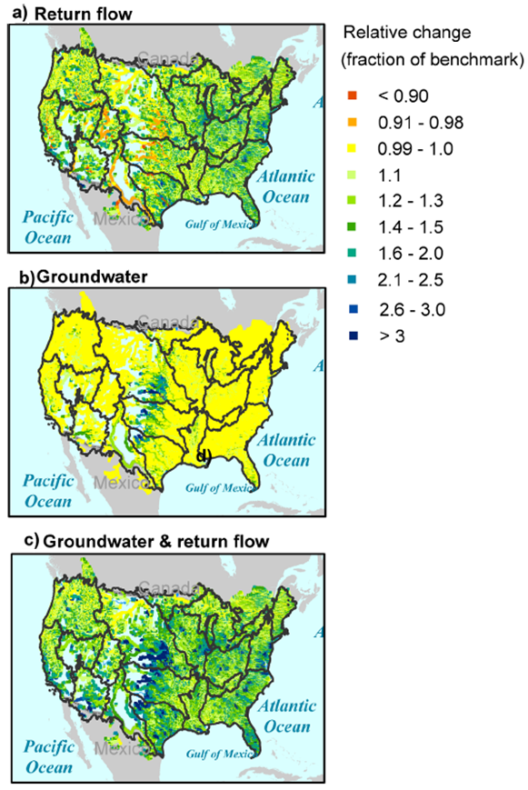
Accounting for Groundwater Use and Return Flow Improves Modeling of Water Management
Objective
Refine Earth system modeling of water management by considering groundwater use and return flow, and differentiating sectoral (irrigation/non-irrigation) water demands
Approach
Extend an integrated water model based on a river transport model coupled to a water management model and a regional integrated assessment model to represent groundwater use and return flow, and explicitly addressing sectoral water demand input
Perform numerical experiments over the United States at 1/8-degree resolution
Evaluate the simulations using water supply deficit as a metric
Fractional change in mean annual regulated flow due to the inclusion of (a) return flow only; (b) groundwater use only; and (c) both groundwater use and return flow. Yellow indicates no change, green to blue indicates increase, and orange to red indicates drying. The effect of return flow shows a east-west contrast dominated by water withdrawal demand in the eastern U.S.
Impact
Advanced capability to model water management in Earth system models
Groundwater use and return flow shown to have large influences on redistribution of water resources and deficits in the United States
Voisin N, MI Hejazi, LR Leung, L Liu, M Huang, H-Y Li, and T Tesfa. 2017. “Effects of Spatially Distributed Sectoral Water Management on the Redistribution of Water Resources in an Integrated Water Model.” Water Resources Research 53:4253-4270. DOI: 10.1002/2016WR019767
Notes:
http://www.pnnl.gov/science/highlights/highlights.asp?division=749

