Slide 1
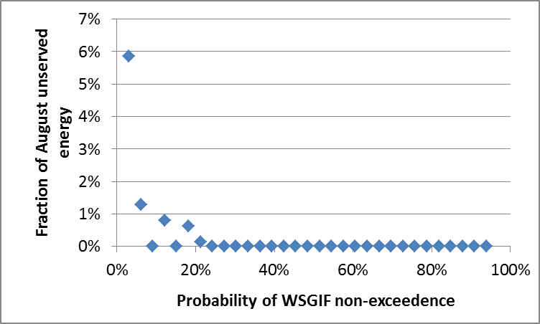
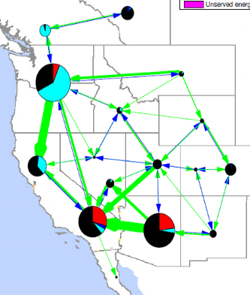
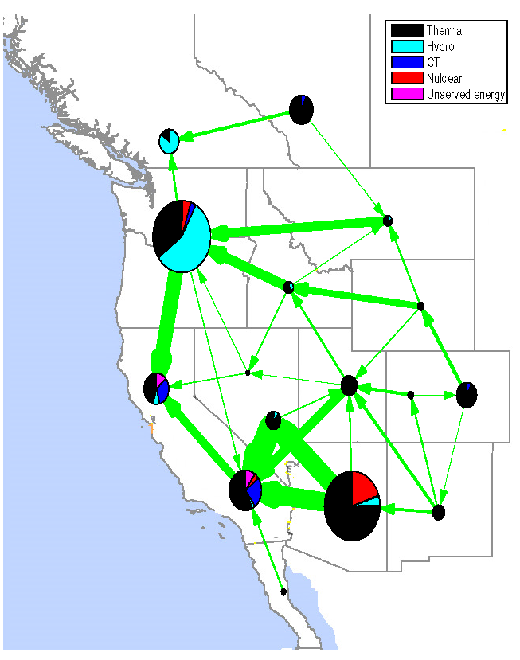
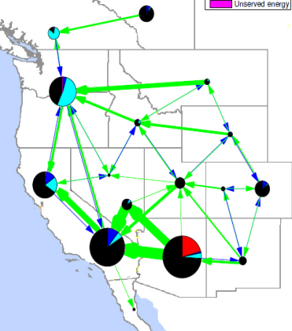
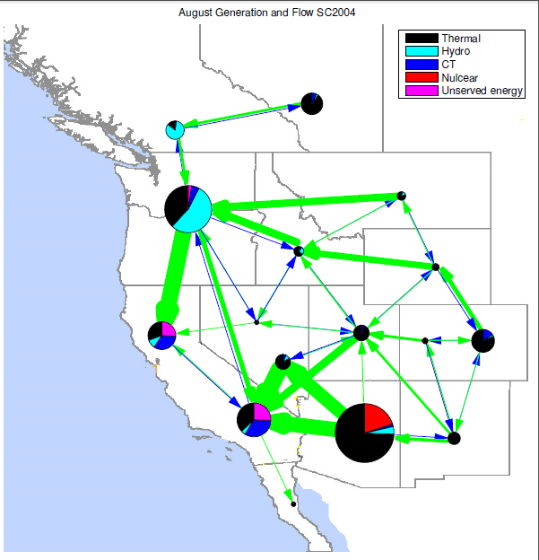
U.S. Western Electric Grid Vulnerability to Hydro-Climatological Conditions: How Bad Can It Get?
Objective
Understand the vulnerability of Western U.S. grid operations to drought conditions
Approach
Developed a grid-centric drought severity index
Used integrated water supply and demand modeling to simulate 30 years of historical water availability
Quantified the impacts of droughts on summer grid operations using a production cost model that accounts for drought-related de-rating of hydropower generation and thermoelectric plant capacity
Specific drought patterns drive to higher vulnerability
This is how bad it could get, 3% chance it could be worse.
Dry West
Regional generation portfolio and transmission
System performance threshold
Dry PNW
Baseline
Baseline
Thermal
Hydro
CT
Nuclear
Unserved
Wet conditions
Severe drought conditions
Risk distribution as a function of drought conditions
Impact
Established a risk distribution for grid performance as a function of inter-annual water availability
21% chance that some demand could not be met in August, 3% chance that unserved energy could exceed 6%.
Identified drought patterns driving to higher vulnerability, which is useful for informing grid planning and adaptation and mitigation scenarios
Dry PNW
Voisin N, M Kintner-Meyer, J Dirks, R Skaggs, D Wu, T Nguyen, Y Xie, M Hejazi. 2016. “Vulnerability of the US Western Electric Grid to Hydro-Climatological Conditions: How Bad Can it Get?” Energy 115: 1-12.
DOI: 10.1016/j.energy.2016.08.059
Dry West
Notes:
http://www.pnnl.gov/science/highlights/highlights.asp?division=749

