Slide 1
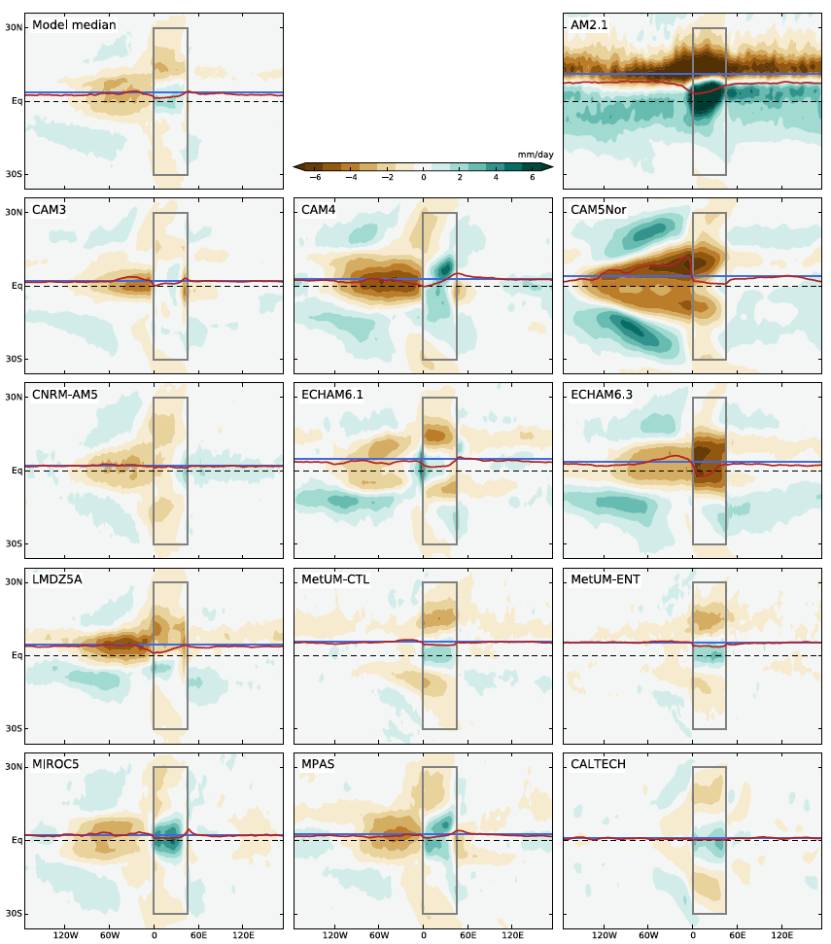
The Tropical Rain Belts with an Annual Cycle and a Continent Model Intercomparison Project: TRACMIP
Objective
Design, perform, and analyze a set of idealized modeling experiments to understand what controls the tropical rain belt and its response to climate change
Approach
TRACMIP includes five idealized modeling experiments: two with an all-ocean planet and three with an idealized tropical continent on an otherwise all-ocean planet
TRACMIP involves 14 atmospheric models coupled to slab ocean models
Researchers performed simulations with seasonally varying solar insolation and CO₂ concentrations corresponding to the present-day and quadrupling of CO₂
Impact
Addressing the question of what controls the tropical rain belts, TRACMIP sheds light on different aspects of the dynamics of tropical rainfall and global climate change
Diverse response of precipitation to the presence of a tropical continent in 14 global models
Voigt A, M Biasutti, J Scheff, J Bader, S Bordoni, F Codron, R Dixon, S Kang, N Klingaman, LR Leung, J Lu, B Mapes, E Maroon, S McDermid, J-Y Park, R Roehrig, B Rose, J Seo, M Yoshimori, LR Vargas Zeppetello. 2016. “The Tropical Rain Belts with an Annual Cycle and Continent Model Intercomparison Project: TRACMIP.” Journal of Advances in Modeling Earth Systems 8. DOI: 10.1002/2016MS000748
Notes:
http://www.pnnl.gov/science/highlights/highlights.asp?division=749

