Slide 1
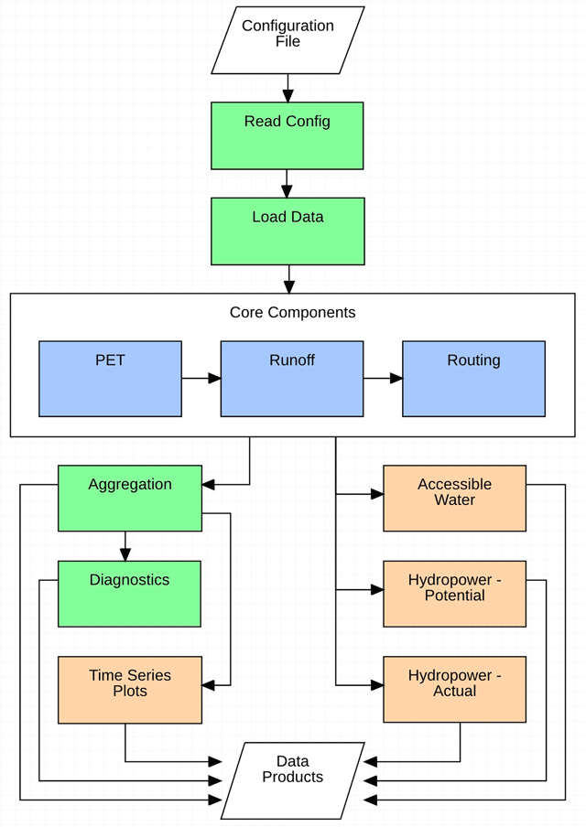
A Global Hydrologic Framework to Accelerate Scientific Discovery
Objective
For version 2 of the Xanthos global hydrology model, create a component-based framework that allows scientists to quickly integrate, test, and use hydrologic process modules within Xanthos
Approach
Develop and offer a suite of interchangeable core components for potential evapotranspiration (PET), runoff, and routing that allows users to easily select a desired configuration
Build in a calibration component that allows for easy recalibration with user-selected forcing data
Establish multiple post-processing components, such as hydropower potential, to add the ability to tailor configurations to research needs
Impact
Xanthos version 2 enables scientists to rapidly address complex multisector dynamics science challenges
Researchers can explore the role of model physics and parameterization in uncertainty characterization by using different configurations of tools within Xanthos
This is the default configuration for Xanthos version 2. Green components provide built-in functionality. Blue components are the interchangeable core modules. Orange components are post-processing modules that have been extended.
Vernon CR, MI Hejazi, SWD Turner, Y Liu, CJ Braun, X Li, and RP Link. 2019. “A Global Hydrologic Framework to Accelerate Scientific Discovery.” Journal of Open Research Software 7(1):1, http://doi.org/10.5334/jors.245.

