Slide 1
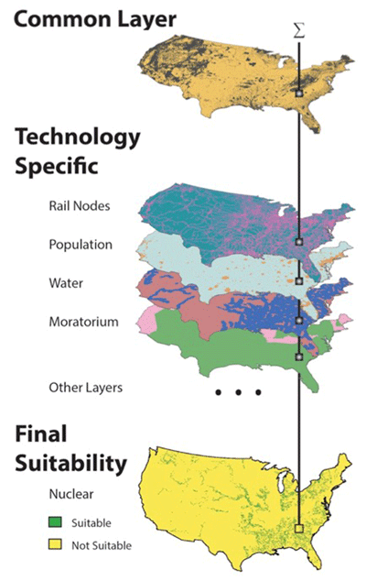
CERF – A Geospatial Model for Assessing Future Electricity Capacity Expansion
Objective
Improve the realism of future scenarios by developing an open-source, multi-sector, multi-scale model that can evaluate the on-the-ground feasibility of electricity infrastructure expansion plans
Approach
Evaluate the suitability of each 1 km² grid cell for siting of 17 different energy technologies, considering a broad range of physical, environmental, and regulatory factors
Determine the interconnection costs and net operational value of each potential site to yield a net locational cost
Use this information to assess the feasibility of different capacity expansion scenarios from an integrated human-Earth system model such as GCAM
Impact
CERF will improve projections of future energy system growth and, ultimately, attendant changes in the integrated human-Earth system
The CERF model considers economic, environmental, and practical constraints that influence power plant siting.
Vernon CR, N Zuljevic, JS Rice, TE Seiple, MCW Kintner-Meyer,
N Voisin, IP Kraucunas, C Jin, J Olson, L Schmidt, SL Morris, P Patel. 2018. “CERF – A Geospatial Model for Assessing Future Energy Production Technology Expansion Feasibility,” Journal of Open Research Software 6(1):20. DOI: 10.5334/jors.227.

