Slide 1
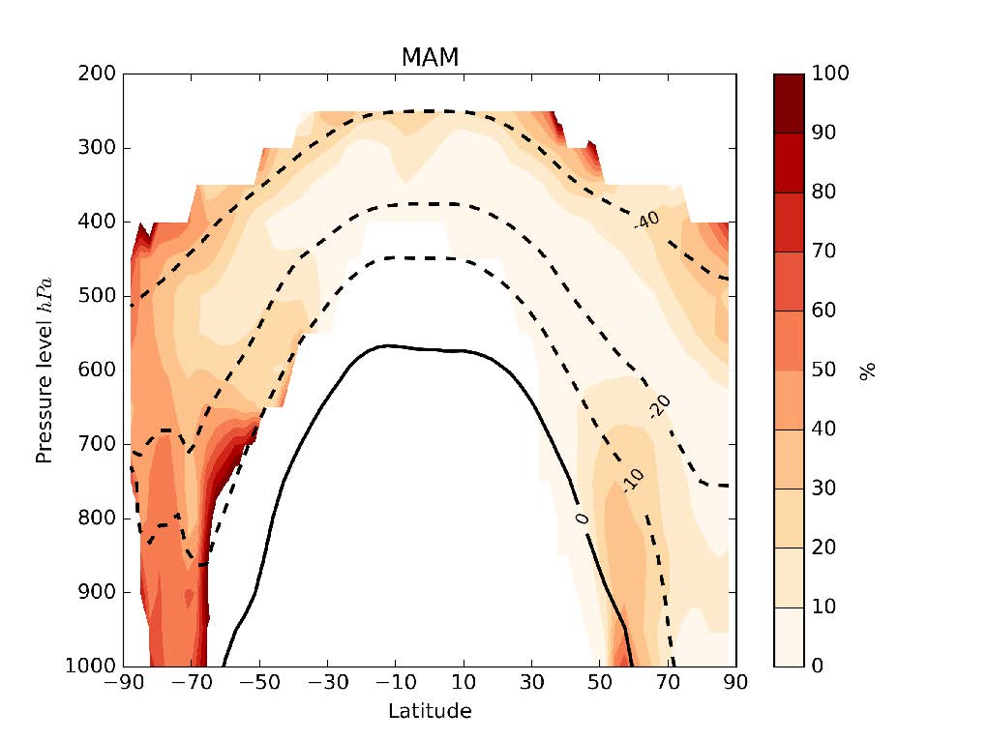
Marine Organic Spray an Important Contributor to Cloud Freezing at High Latitudes
Objective
Determine relevance of marine organic aerosol as a source of ice nucleating particles (INP) in mixed-phase clouds
Approach
Implement marine organic aerosol emissions into a chemical transport model. Also simulate K-feldspar, a globally important mineral INP source
Percentage of days (March-May) when marine organic aerosol provides dominant source of INP at ambient temperature
Simulate the number of these two particle types capable of causing cloud droplet freezing at the model’s ambient temperature and compare with observations of ambient INP
Calculate the number of days on which marine organics dominate INP because aerosol concentrations are highly variable over time
Impact
Marine organic aerosol is estimated to be the dominant summertime source of INP at latitudes south of 60 S, and a dominant source at locations in the Northern Hemisphere on many days each month.
This work shows that the contributions to ice nucleation by both marine organic aerosol and K-feldspar need to be treated in global atmospheric models in order to adequately represent the distribution of INP.
Jesús Vergara-Temprado, Benjamin J. Murray, Theodore W. Wilson, Daniel O'Sullivan, Jo Browse, Kirsty J. Pringle, Karin Ardon-Dryer, Allan K. Bertram, Susannah M. Burrows, Darius Ceburnis, Paul J., Ryan H. Mason, Colin D. O'Dowd, Matteo Rinaldi, and Ken S. Carslaw 2017. “Contribution of Feldspar and Marine Organic Aerosols to Global Ice Nucleating Particle Concentrations.” Atmospheric Chemistry and Physics 17, 3637-3658. DOI: 10.5194/acp-17-3637-2017
Notes:
http://www.pnnl.gov/science/highlights/highlights.asp?division=749

