Slide 1
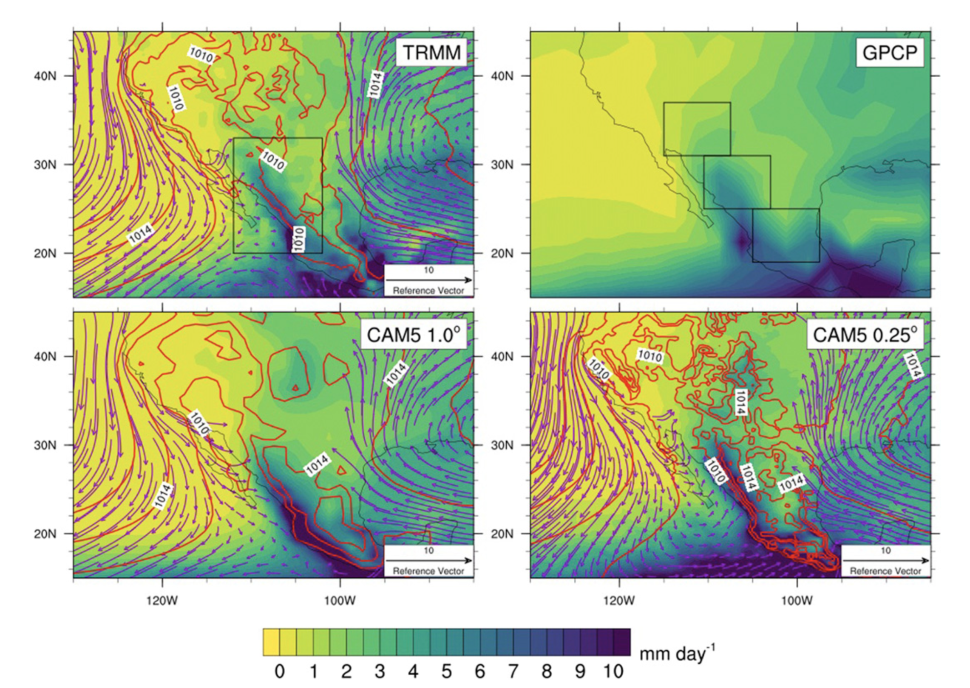
Characterizing the North American Monsoon in the Community Atmosphere Model: Sensitivity to Resolution and Topography
Arianna M. Varuolo-Clarke, Kevin A. Reed, and Brian Medeiros
Journal of Climate, https://doi.org/10.1175/JCLI-D-18-0567.1
Objective
Evaluate the roles of horizontal resolution and topography on the North American Monsoon.
Approach
Compare precipitation and circulation of the North American Monsoon in observations to 1° and 0.25° configurations of CAM5.
CAM simulations forced by observed SST, 1979-2005.
Analyze regional precipitation timing and intensity.
Apply moist static energy budget analysis to understand dynamics of the monsoon.
Impact
CAM5 at 1° has some realistic features, but transitions into and out of the monsoon too gradually and does not reach far enough into the southwest USA.
CAM5 at 0.25° grid spacing has a better northward extent of the monsoon. There is evidence that this is due to the improved topography, especially of Baja California, allowing channeling of water vapor along the Gulf of California.
Even at high-resolution, there are biases in the monsoon rainfall, but this study shows promise for high-resolution climate models to better capture the North American Monsoon, including how it will change in the future..
North American Monsoon precipitation (mm/day) averaged over the monsoon season (July-September) for observations (TRMM & GPCP, top), and the 1° and 0.25° CAM5 simulations (bottom). Sea level pressure (red; hPa) and 925-hPa wind (purple; m/s, from MERRA-2 over TRMM) are also shown. The sea level pressure is contoured from 1010 to 1016 hPa by 2 hPa.

