Slide 1
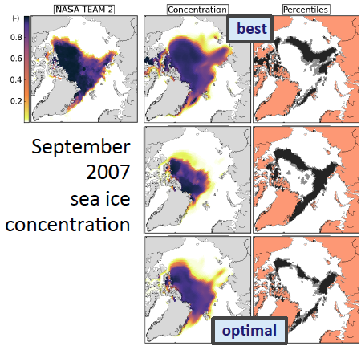
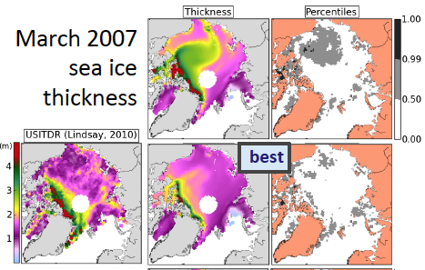
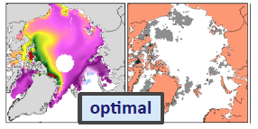
Using an uncertainty-based metric for sea ice model validation
Objective
Validation of sea ice models is challenging because deviations of model results from observations could originate from errors and uncertainties in the observations, the model, or both. A model configuration can perform well for one simulated sea ice quantity, but poorly for other. The objective is to develop a robust probabilistic approach to the validation problem of sea ice models.
Approach
We propose a distance metric that follows a Gamma distribution. The distance measure (D_{n}) is computed by summing the squares of the z-scores between n observational and model data pairs.
The scale and shape parameters associated with D_{n}, are computed from model and observational data, and their associated uncertainties. The level of agreement between model and observations is given by the quantile of D_{n} in the estimated distribution: Low values indicate good matches.
Impact
We developed an objective distance metric that allows incorporation of model and observational uncertainties in validation assessments. The metric can also be used to evaluate multiple variables. We identified the model configurations in Los Alamos Sea Ice model that produce optimized agreements for thickness and concentrations.
Distance metric combines multi-variable uncertainties from model and observations
Urrego-Blanco, J. R., E. C. Hunke, N. M. Urban, N. Jeffery, A. K. Turner, J.R. Langenbrunner, and J. Booker (2017), Validation of sea ice models using an uncertainty-based distance metric for multiple model variables, J. Geophys. Res. Oceans, 122, 2923–2944, doi:10.1002/2016JC012602.

