Slide 1
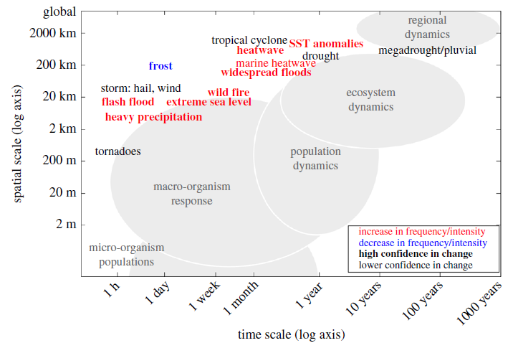
Extreme weather and climate events with ecological relevance
Objective: Earth System Models that simulate biogeochemical cycles and interactions with the biosphere at increasing complexity make it possible to develop a mechanistic understanding of how extreme climate events (ECEs) affect biological processes, ecosystem functioning and adaptation capabilities.
Research:
--There is robust evidence that certain extreme weather and climate events, especially daily temperature and precipitation extremes, have changed with regards to intensity and frequency over recent decades
-- Improvements are needed in the observational network, both for physical earth system parameters and even more so for long-term ecological monitoring, to improve understanding of bio-physical interactions across a range of scales.
Spatial and temporal scales of typical ECEs and scales of biological systems (shaded grey). Individuals, populations and ecosystems within these respond to
environmental stressors. Red (blue) labels indicate an increase (decrease) in the frequency or intensity of the event, with bold font reflecting confidence in the
change. ECEs are likely to affect biological systems at all temporal and spatial scales located to the left and below the specific ECE position in the figure
Impact: New opportunities for assessing how ECEs modulate ecosystem structure and functioning arise from better scientific understanding of ECEs coupled with technological advances in modeling, observing systems and instrumentation.
Ummenhofer, C.C., and G.A. Meehl, 2016: Extreme weather and climate events with ecological relevance: a review. Philosophical Transactions of the Royal Society of London B, 372, 20 160 135, http://dx.doi.org/10.1098/restb.2016.0135.

