Slide 1
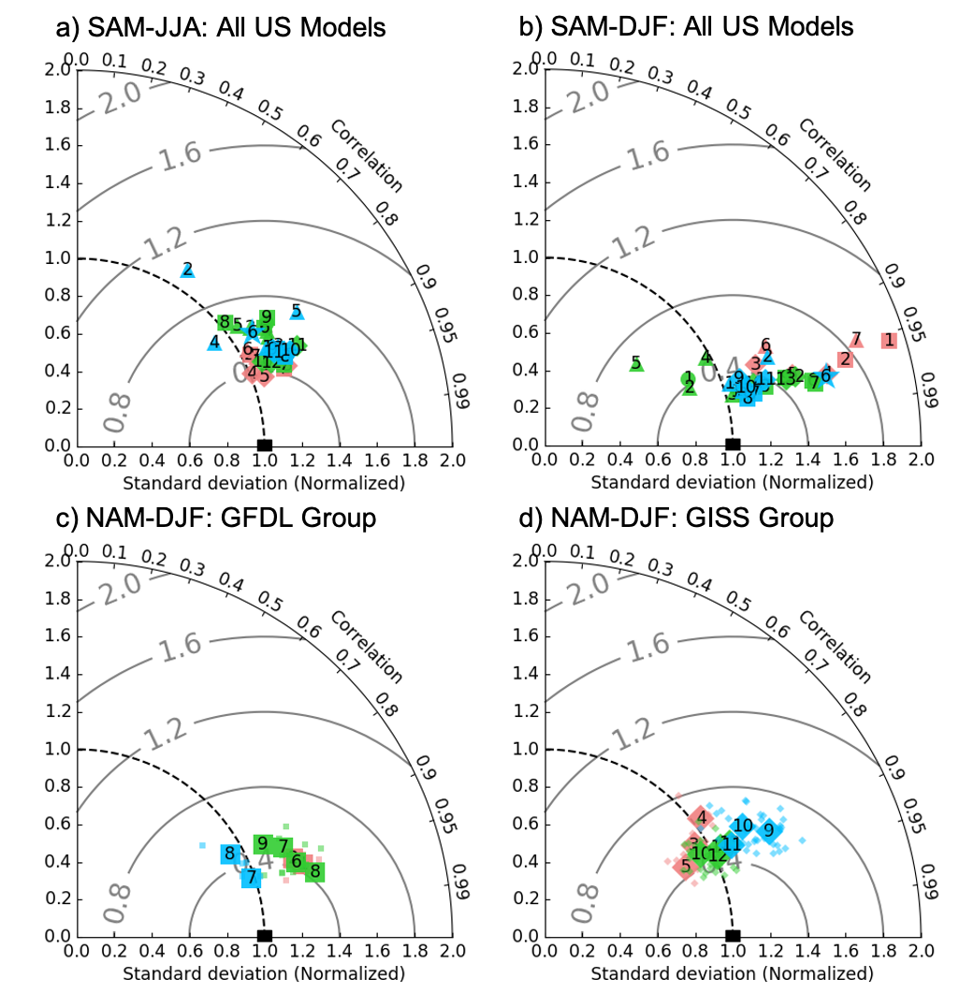
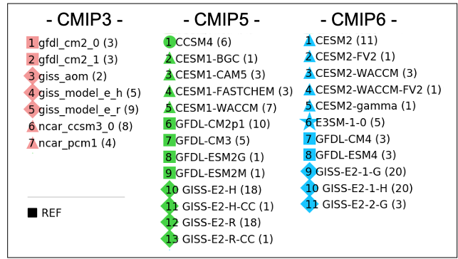

Representation of Modes of Variability in 6 U.S. Climate Models
Scientific Achievement
With this multi-agency collaboration effort, we compare the performance of several modes of variability across six US climate modeling groups, with a focus on identifying robust improvements in recent models (including those participating in the Coupled Model Intercomparison Project (CMIP) Phase 6) compared to previous versions.
Significance & Impact
We find clear and systematic improvements in the MJO and QBO and in the teleconnection patterns associated with the PDO and ENSO. Some gains arise from better process representation, while others (e.g. the QBO) from higher resolution that allows for a greater range of interactions. Our results demonstrate that the incremental development processes in multiple climate model groups lead to more realistic simulations over time.
Research summary
We examined the representation of various climate modes of variability, such as MJO, ENSO, PDO, QBO, SAM, NAM, NAO, and PNA, in the US climate models those participated CMIP3, 5, and 6. Where feasible, we explore the processes driving these improvements through the use of “intermediary” experiments that utilize model versions between CMIP3/5 and CMIP6 as well as targeted sensitivity experiments in which individual modeling parameters are altered.
Comparing performance of US models those participated CMIP3, 5, and 6 on reproducing of extratropical modes of variability.
Orbe, C., L. V. Roekel, A. Adames, G. Danabasoglu, A. Dezfuli, J. Fasullo, Peter Gleckler, Jiwoo Lee, W. Li, L. Nazarenko, G. Schmidt, Ken Sperber, M. Zhao, 2020: Representation of Modes of Variability in 6 U.S. Climate Models. Journal of Climate, (in press) doi: 10.1175/JCLI-D-19-0956.1

