Slide 1
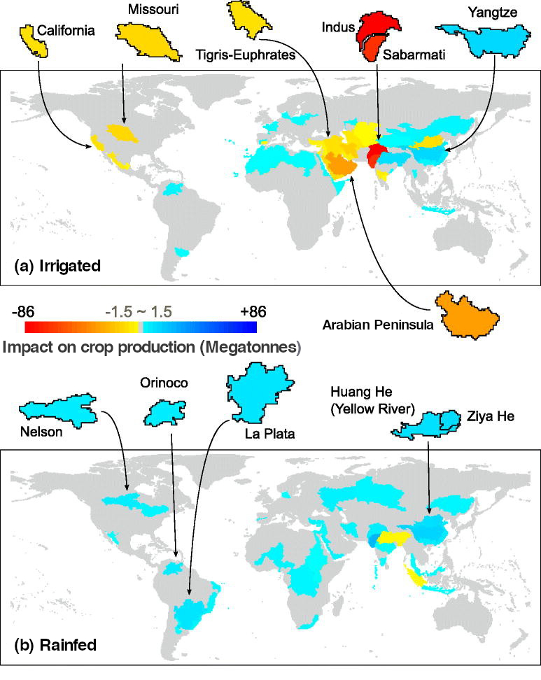
A Pathway of Global Food Supply Adaptation in a World with Increasingly Constrained Groundwater
Objective
Assess the capacity of the global agriculture sector to adapt in a world with decreasing groundwater reserves
Approach
Embed global groundwater resource cost curves into the Global Change Assessment Model
Simulate the behaviors of water users facing increasing costs and restricted availability of groundwater—and then compare simulations against a scenario without these constraints
Impact
Study identified ways in which agriculture sector could adapt to meet global food demands by the year 2100
Agriculture sector may be able to adapt through marginal increases in irrigated and rainfed production across regions where water remains plentiful
Regions with unsustainable groundwater use could experience major agricultural and economic declines
Relative to a scenario of limitless groundwater, simulated crop production facing realistic costs and limits on groundwater extraction is less reliant on (a) irrigated crop production and more reliant on (b) rainfed crop production.
Turner SWD, M Hejazi, K Calvin, P Kyle, and S Kim. 2019. “A pathway of global food supply adaptation in a world with increasingly constrained groundwater.” Science of The Total Environment 673:165‒176, https://doi.org/10.1016/j.scitotenv.2019.04.070.
Notes:
http://www.pnnl.gov/science/highlights/highlights.asp?division=749

