Slide 1
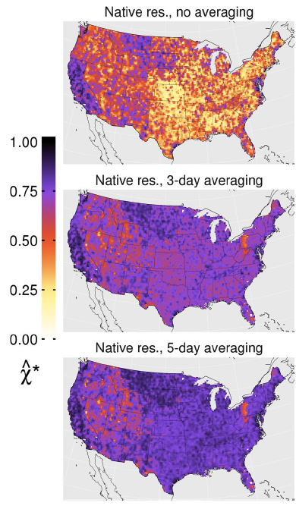
An evaluation of the consistency of extremes in gridded precipitation data sets
This paper compares the representation of extremes in a number of widely used daily gridded observational products over the CONUS, derived from rain gauge data, satellite retrieval and reanalysis for the counterminous United States. Analysis is based upon the concept of ``tail dependence'' arising in multivariate extreme value theory, and we infer the level of temporal dependence in the joint tail of the precipitation probability distribution for pairwise comparisons of products. Linear correlation between products is also computed.
Our paper “raises rather challenging—even awkward— questions over the accuracy of gold standard gridded products that face a myriad of applications in a leading scientific nation.” This quote summarizes our finding that we have shaken any confidence in extreme precipitation in gridded observational products. Even after removing whatever quantitative biases these products may have, the various products do not agree well on what days in the record are actually extreme. Especially for satellite based datasets, this uncertainty in the timing of extremes undermines confidence of their usage in event attribution as well as numerical weather prediction model verification.
Tail dependence parameter between two different gridded estimates of the same station data. This parameter is similar tp correlation but focuses on extremes. Agreement is much worse between these products and satellite products.
Ben Timmermans, Michael Wehner, Dan Cooley, Travis O’Brien, Hari Krishnan (2019) An evaluation of the consistency of extremes in gridded precipitation data sets. Early release Climate Dynamics. https://doi.org/10.1007/s00382-018-4537-0

