Slide 1
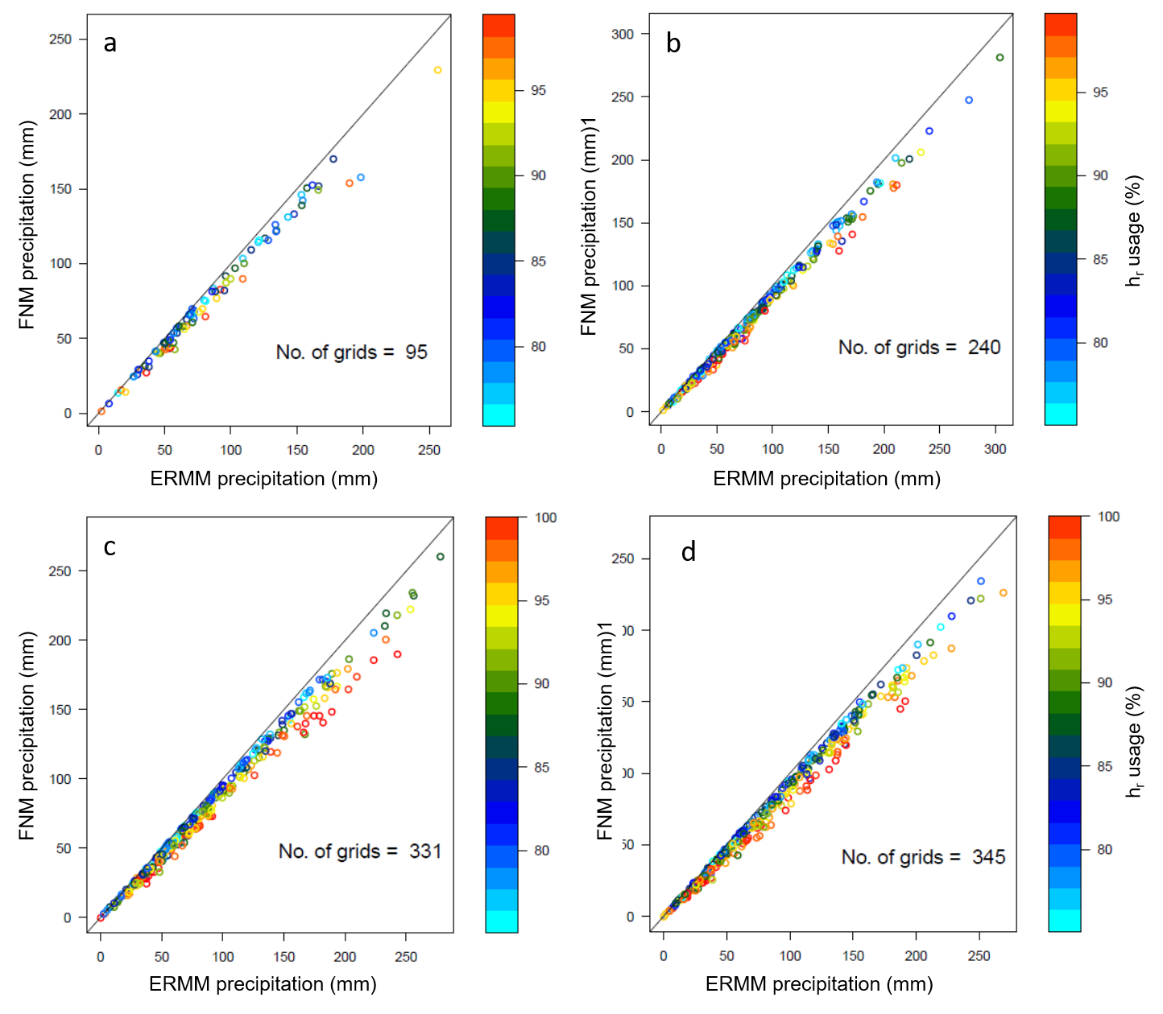
Exploring Topography-Based Downscaling Methods of Precipitation
Objective
Develop precipitation downscaling methods that can be implemented in the Energy Exascale Earth System Model (E3SM) to represent the terrain effects on precipitation and subsequent influence on land surface processes
Approach
Developed simple, topography-based downscaling methods of precipitation and applied them to disaggregate coarse grid precipitation data into fine resolution grids
Compared and evaluated methods’ performance for their capability to capture the observed spatial pattern of precipitation as depicted by the high-resolution (4 km) PRISM data over the conterminous United States
Impact
Revealed that utilizing elevation measurements and accounting for airflow blocking improved precipitation downscaling in mountainous regions
Selected two of these methods for implementation in E3SM to enhance its ability to simulate and predict freshwater supply. This supply has downstream implications for water, energy, and food production
The FNM method of downscaling, which accounts for topographic blocking of airflow, consistently simulates lower precipitation than the ERMM method across spatial resolutions of 32 km (a), 64 km (b), 96 km (c), and 128 km (d). The differences between the methods are larger when blocking occurs more often (higher h_{r} usage shown in colors), demonstrating the important effect of topographic blocking on precipitation in mountain areas.
TK Tesfa, LR Leung, and SJ Ghan. 2020.” Exploring Topography‐Based Methods for Downscaling Subgrid Precipitation for Use in Earth System Models.” Journal of Geophysical Research: Atmospheres, 125: e2019JD031456.
DOI: 10.1029/2019JD031456

