Slide 1
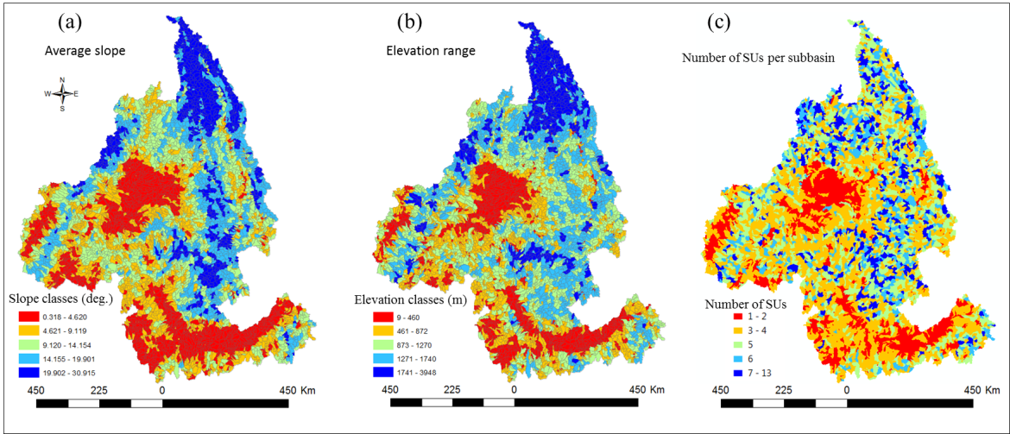
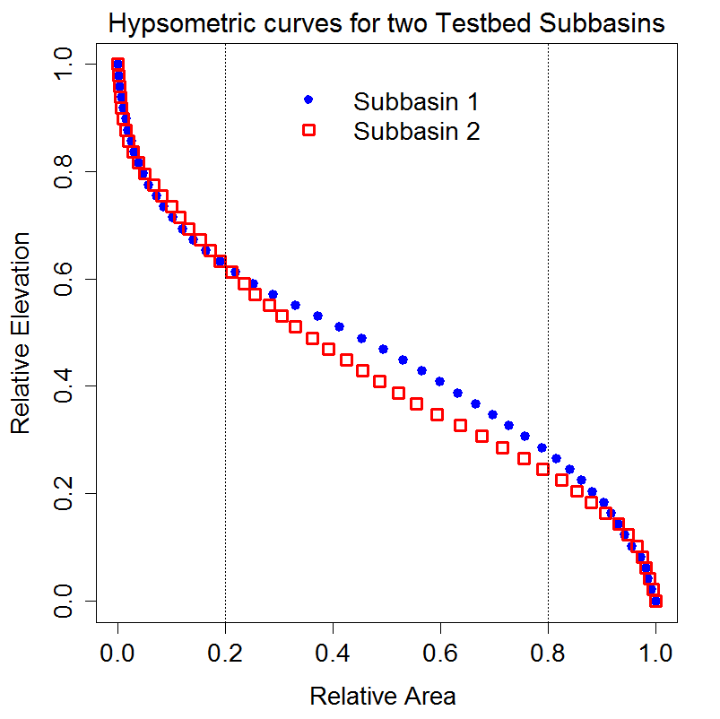
New Topography-Based Subgrid Units Improve Land-Surface Modeling
Objective
Evaluate new topography-based spatial units and methods of dividing watersheds into spatial units (delineation) for topographic diversity to improve land-surface modeling
Approach
Developed algorithms of watershed delineation (local and global) to obtain topography-based spatial units
Applied the methods over a topographically diverse region of the northwestern United States to develop geolocated and nongeolocated spatial units
Evaluated the methods and spatial units for their ability to capture topographic diversity and the implications for representations of atmospheric forcing and land-cover spatial patterns
TOP: Spatial patterns of average slope (a) and elevation range (b) of the watershed over the Columbia River basin are compared against the spatial pattern of the number of subgrid units per watershed (c) obtained using the local method
RIGHT: Hypsometric curves of two watersheds with contrasting elevation variability
Head
Body
Toe
Impact
Adopting geomorphologic concepts in watershed delineation improves capability to capture subgrid topographic diversity
Climatic and land-cover variability will be better represented with only a nominal increase in computational requirements
Tesfa TK and LR Leung. 2017. “Exploring New Topography-Based Subgrid Spatial Structures for Improving Land Surface Modeling.” Geoscientific Model Development 10, 873-888. DOI: 10.5194/gmd-10-873-2017
Notes:
http://www.pnnl.gov/science/highlights/highlights.asp?division=749

