Slide 1
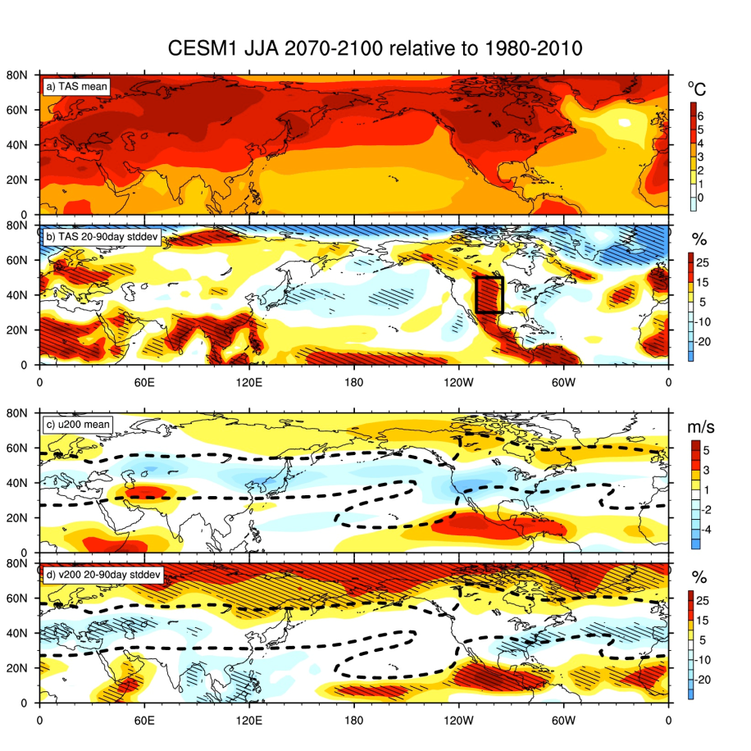
Projected Intensification of Subseasonal Temperature
Variability and Heat Waves in the Great Plains
Haiyan Teng and Grant Branstator
Objective
Diagnose summertime subseasonal temperature variability change in response to anthropogenic forcing
Understand the mechanism for possible changes
Approach
Analyze the CESM1 large ensemble
Use a linear stationary wave model to help interpret the CESM1 results
Impact
Summertime subseasonal temperature variability in the US Great Plains is enhanced by approximately 20% in 2070-2100 relative to 1980-2010
The intensified future temperature variability and heat waves are caused by enhanced atmosphere-land interaction due to future warmer/drier mean climate, rather than amplified planetary wave variability as suggested by numerous hypotheses.
Change in JJA seasonal mean and subseasonal variability from 1980-2010 to 2070-2100 in CESM1-LE. a) and c), seasonal mean change in surface air temperature (TAS) and 200 hPa zonal wind (u200) respectively. b) and d), percentage change in standard deviation of 20-90day filtered TAS and 200 hPa meridional wind (v200).
Teng, H. and G. Branstator, 2016: Projected intensification of subseasonal temperature variability and heat waves in the Great Plains, Geophy. Res. Lett. in press.

