Slide 1
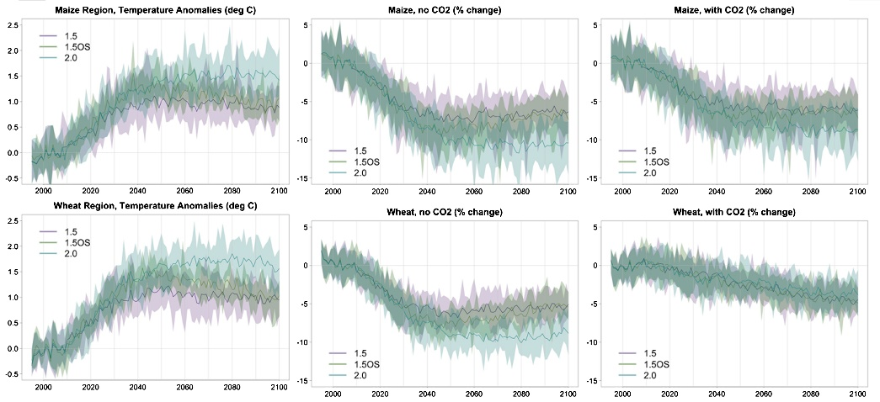


Differences, or lack thereof, in wheat and maize yields under three low-warming scenarios
Objective: Analyze future changes in maize and wheat yields the low-warming scenarios motivated by the Paris targets in order to understand if the half degree difference in global temperature produces significant benefits for these two staple crops.
Research: Taking advantage of a suite of ensemble simulations targeting the warming levels of 1.5 and 2 degrees, we analyze through an empirical model of the relation between crop yield anomalies and temperature and precipitation changes, with or without the inclusion of CO₂ fertilization effects, ensembles of time series of yield outcomes over the course of the 21st century, for each scenario. If CO₂ effects are not included, statistically significant differences in yields of both crops appear as early as the 2030s but the magnitude of the differences remains below 3% of the historical baseline in all cases. The inclusion of CO₂ effects erases all significant benefits of mitigation for wheat, while the significance of differences is maintained for maize yields between the higher and the two lower scenarios, albeit with smaller benefits in magnitude. Changes in extremes are significant within each of the scenarios but the differences between any pair of them, even by the end of the century are only on the order of a few days per growing season
Left panels: time series of CESM simulated temperature averaged over the crop's growing season and region (the latter according to weights proportional to the fraction of grid cell cultivated); values are anomalies with respect to the 1995−2014 average. Center and right panels: time series of estimated percent changes from the 1995−2014 average yield for each of the crops, without including CO₂ fertilization effects and including them. In each panel three set of experiments are shown: twelve member ensembles for 1.5 and 2.0 scenarios and nine member ensembles for 1.5OS. Thick lines are ensemble means, shaded envelopes bound the ensemble ranges.
Impact : Our results suggest that for globally averaged yields of these two grains the lower targets put forward by the Paris agreement does not change substantially the expected impacts on yields that are caused by warming temperatures under the pre-existing 2.0 °C target.
Tebaldi, C. and D. Lobell, 2018: Differences, or lack thereof, in wheat and maize yields under three low-warming scenarios. Env. Res. Lett., http://iopscience.iop.org/article/10.1088/1748-9326/aaba48

