Slide 1
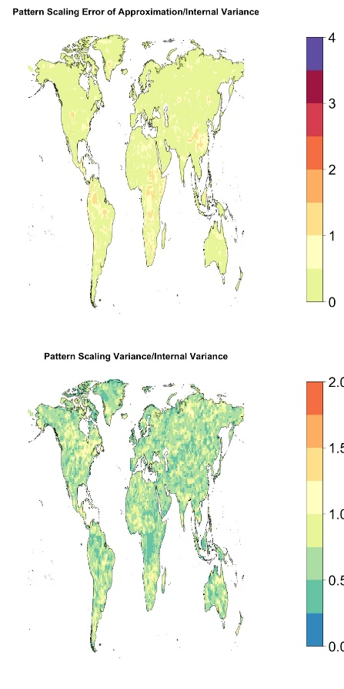
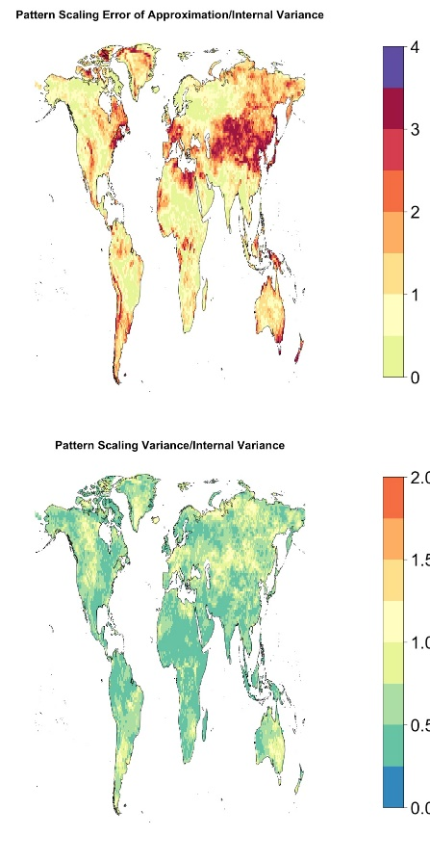
Emulating Climate Extreme Indices
Objective
Test the applicability of two methods - simple pattern scaling and time-shift - of climate model output emulation to represent indices of temperature and precipitation extremes.
Approach
Used several initial condition ensembles from CESM1-CAM5 to compute 5 indices of temperature extremes and 5 indices of precipitation extremes.
Identified indices that present special challenges to the emulation and investigated the reasons for the lower performance in some regions of the world.
Devised a novel performance metric able to distinguish systematic error from the noise of internal variability, when initial condition ensembles are available to train the emulators.
Impact
Most indices were well emulated by the two methods.
Representing extremes in a computationally efficient manner enhances impact modeling, because many significant impacts are driven by extremes of temperature and precipitation.
Error of Approximation/Internal Variance
4.0
3.0
2.0
1.0
0.0
Emulator Variance/Internal Variance
2.0
1.5
1.0
0.5
0.0
This figure shows the performance of simple pattern scaling in emulating two indices, one measuring precipitation intensity (left) and one measuring length of heatwaves (right). The upper panels show a measure of systematic error, with the index on the right revealing areas of large errors (red hues). The lower panels show a measure of internal variability of emulated versus true quantities, showing that pattern scaling reduces internal variability.
Tebaldi C, AA Armbruster, HP Engler, and R Link. 2020. “Emulating climate extreme indices,” Environmental Research Letters in press.
DOI: 10.1088/1748-9326/ab8332
Notes:
http://www.pnnl.gov/science/highlights/highlights.asp?division=749

