Slide 1
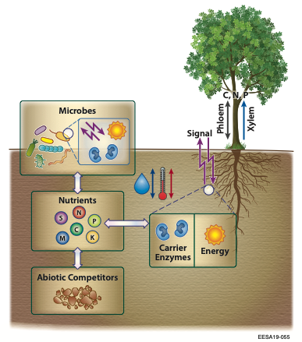
A review of modeling paradigms of plant root nutrient acquisition
Scientific Achievement
Land models need robust mechanistic representation of plant root nutrient acquisition.
We reviewed three existing modeling paradigms and their relationships to relevant biogeochemical processes and observations.
Significance and Impact
Only the capacity-based approach was found to be able to resolve essential biogeochemical processes.
Plant-shoot nutrient coupling is asynchronous such that root nutrient uptake can occur in the absence of photosynthesis.
Figure. Plant root nutrient acquisition involves the coupling of three classes of processes: (NA1) activity of nutrient acquiring proteins (i.e., pumps, transporters, and channels distributed over the lipid bilayer membrane of root or mycorrhizal cells, and is typified by light blue carrier enzymes), (NA2) maintenance of nutrient stoichiometry (which signals nutrient demand as indicated by purple arrows), and (NA3) energy expenditure (indicated by the orange sun-shape).
Research Details
We reviewed the biogeochemistry involved in plant root nutrient uptake.
We reviewed empirical data on temporal nutrient uptake.
We examined three modeling paradigms against the biogeochemical principles and empirical observations.
We are integrating these finding into ELM.
Tang, J.-Y. and Riley, W. J.: On the modeling paradigm of plant root nutrient acquisition. Plant Soil (2021). https://doi.org/10.1007/s11104-020-04798-5.

