Slide 1


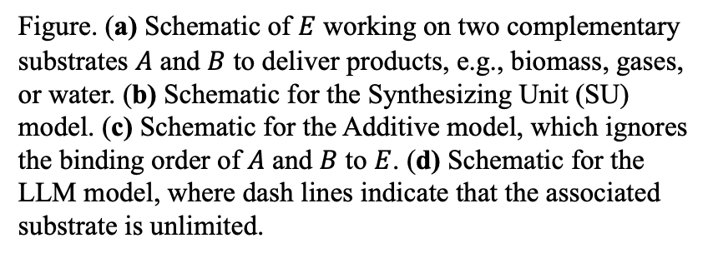
Finding Liebig’s Law of the Minimum
Scientific Challenges
Biological growth has multiple substrate co-limitations
We derived different approximations to the Law of Mass Action model, and identified limitations of the widely used Liebig’s Law of the Minimum model
Approach and Results
We derived three approximations to the Law of Mass Action model of multiple-substrate co-limited growth
We benchmarked the three models with microbial and plant growth data
Figure. (a) Schematic of $E$ working on two complementary substrates $A$ and $B$ to deliver products, e.g., biomass, gases, or water. (b) Schematic for the Synthesizing Unit (SU) model. (c) Schematic for the Additive model, which ignores the binding order of $A$ and $B$ to $E$. (d) Schematic for the LLM model, where dash lines indicate that the associated substrate is unlimited.
Significance
Liebig’s Law of the Minimum model is not compatible with variable elemental stoichiometry of plant and microbial growth
The Additive model is the best representation and it can be readily integrated with ELM to improve predictions of future carbon cycling
Citation: Tang, J.-Y. and Riley, W. J.: Finding Liebig’s law of the minimum. Ecological Applications (2021). https://doi.org/10.1002/eap.2458

