Slide 1
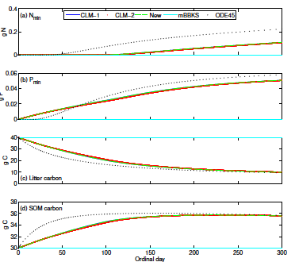
A generic law-of-the-minimum flux limiter for simulating substrate limitation in biogeochemical models
Objective
This paper solves the numerical difficulty in handling multi-substrate co-limitation in all types of biogeochemical models
We demonstrate the approach for a C, N, and P reaction network
Numerical benchmark
Research
Proposed a law of the minimum based flux-limiter to ensure mass-conservative and non-negative numerical solutions to an arbitrary biogeochemical model
Evaluated the new method against existing ad hoc approaches
Impacts
We found:
Models like ALM and CLM are suffering from ambiguity in handling substrate limitation
The new method is more robust and removes the numerical ambiguity in implementing multi-substrate co-limitation
Reference: Tang, J. Y. and Riley, W. J.: Technical Note: A generic law-of-the-minimum flux limiter for simulating substrate limitation in biogeochemical models, Biogeosciences, 13, 723-735, doi:10.5194/bg-13-723-2016, 2016.
Notes:
Wanda says that this is a general slide with no specific reference

