Slide 1
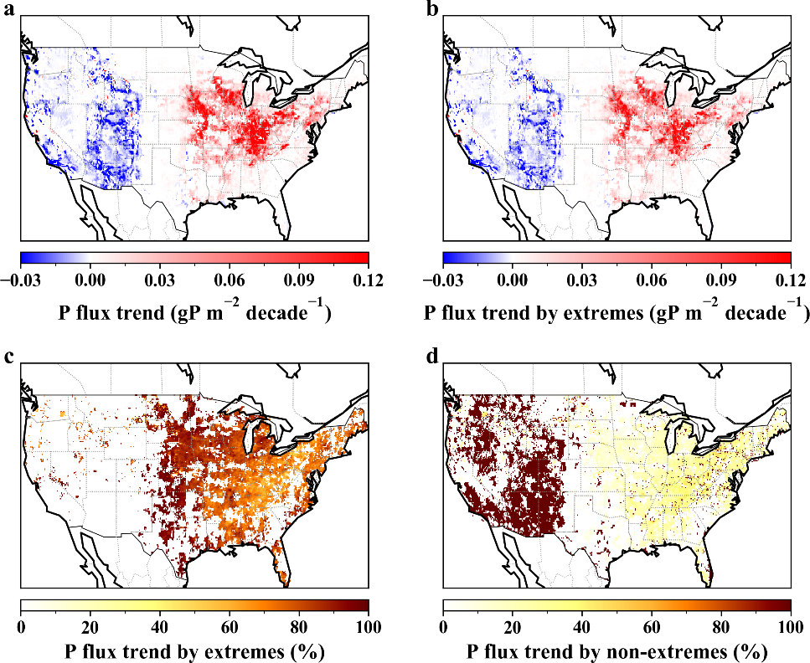
Increased Extreme Rains Bring More Nutrients to the Gulf of Mexico
Objective
Evaluate the impact of climate and land use change on erosion-induced nitrogen and phosphorus lateral fluxes in the United States.
Approach
Represent erosional nutrient fluxes in the Energy Exascale Earth System Model soil erosion model and use the nutrient spiraling method to estimate nutrient retention in rivers.
Perform ensembles of numerical experiments with different climate, land use, and soil biogeochemistry configurations.
Quantify the relative contribution of extreme rainfall, annual rainfall, and land use change to the observed trends of solid-form nutrients in rivers.
Impact
Increased extreme rains drive erosional nutrient fluxes to the drainage basins of the northern Gulf of Mexico increased by over 50% from 1991–2019.
With extreme rains projected to increase with warming, erosional nutrient fluxes in this region will likely continue to rise and complicate future efforts to reduce eutrophication in inland and coastal waters.
Increased extreme rains in the Mississippi river basin intensify erosional nutrient fluxes. (a)-(b) show the phosphorus flux trend caused by the change of total and extreme rainfall, respectively, with clear increases (red) shown for the eastern U.S. (c)-(d) show the relative contribution of extreme and non-extreme rainfall to the phosphorus flux trend, with flux in the eastern U.S. strongly dominated by extreme rainfall.
Z. Tan, L. R. Leung, H.-Y. Li, T. Tesfa, Q. Zhu, X. Yang, Y. Liu, and M. Huang. “Increased extreme rains intensify erosional nitrogen and phosphorus fluxes to the northern Gulf of Mexico in recent decades,” Environmental Research Letters, 16, 054080, (2021). DOI: 10.1088/1748-9326/abf006
Notes:
http://www.pnnl.gov/science/highlights/highlights.asp?division=749

