Slide 1
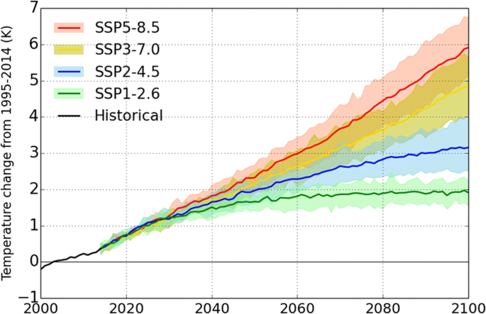
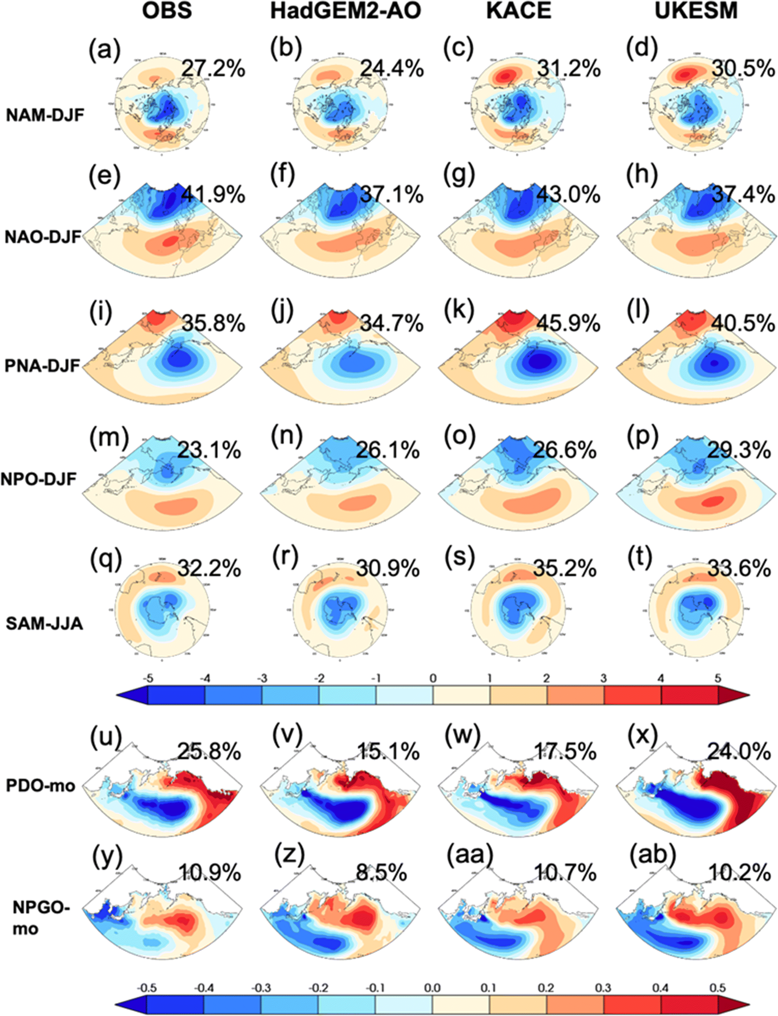

Climate Change Projection in the Twenty-First Century Simulated by NIMS-KMA CMIP6 Model Based on New GHGs Concentration Pathways
Scientific Achievement
The paper extensively evaluate Historical simulations of KMA’s new CMIP6 models and analyze its future projections focusing on mean, variability, and extremes.
Significance & Impact
In the extensive evaluation of Historical simulations of the KMA’s new CMIP6 models, the extratropical modes of variability was examined by using the PCMDI Metrics Package (PMP), which provides a good use case for the PMP from modeling groups.
Time series of global mean surface temperature changes for the historical simulation (black) from 1995 to 2014, and future simulations for four SSP-RCPs (SSP5–8.5 (red), SSP3–7.0 (yellow), SSP2–4.5 (blue), and SSP1–2.6 (green)) from 2015 to 2100, respectively. The shaded area indicates the ensemble spread of six members (both K-ACE and UKESM1)
Research summary
The National Institute of Meteorological Sciences-Korea Meteorological Administration (NIMS-KMA) has participated in the Coupled Model Inter-comparison Project (CMIP) and provided long-term simulations using the coupled climate model. The NIMS-KMA produces new future projections using the ensemble mean of KMA Advanced Community Earth system model (K-ACE) and UK Earth System Model version1 (UKESM1) simulations to provide scientific information of future climate changes. In this study, we analyze four experiments those conducted following the new shared socioeconomic pathway (SSP) based scenarios to examine projected climate change in the twenty-first century. Present day (PD) simulations show high performance skill in both climate mean and variability, which provide a reliability of the climate models and reduces the uncertainty in response to future forcing. In future projections, global temperature increases from 1.92 °C to 5.20 °C relative to the PD level (1995–2014). Global mean precipitation increases from 5.1% to 10.1% and sea ice extent decreases from 19% to 62% in the Arctic and from 18% to 54% in the Antarctic. In addition, climate changes are accelerating toward the late twenty-first century. Our CMIP6 simulations are released to the public through the Earth System Grid Federation (ESGF) international data sharing portal and are used to support the establishment of the national adaptation plan for climate change in South Korea.
The observed (EOF-1 or 2; first column) and simulated (CBF) modes of variability from HadGEM2-AO (second column), K-ACE (third column), and UKESM1 (fourth column), respectively. The percent of variance [%] explained by each EOF or CBF is noted at the upper-right corner of each plot. Units for atmospheric and SST-based modes are hPa and °C, respectively
Sung, H. M., J. Kim , S. Shim, J. Seo , S.-H. Kwon, M.-A. Sun, H. Moon, J.-H. Lee, Y.-J. Lim, K.-O. Boo, Y. Kim, J. Lee, J. Lee, J. Kim, C. Marzin, and Y.-H. Byun, 2021: Climate change projection in the 21 st century simulated by NIMS-KMA CMIP6 model based on new GHGs concentration pathways. Asia-Pacific Journal of Atmospheric Sciences, doi: 10.1007/s13143-021-00225-6

