Slide 1
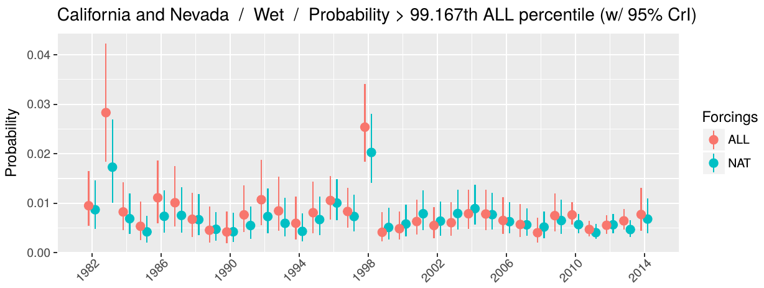
A basis set for exploration of sensitivity to prescribed ocean conditions for estimating human contributions to extreme weather in CAM5.1-1degree
We describe simulations of the CAM5.1-1degree model of the atmosphere run under observed influences from both human and natural sources and under observed influences from natural sources only, following an international experiment protocol. We use the unusual length and number of these simulations to determine what aspects of the experiment design are most important for the robustness of typical extreme weather attribution analyses.
Comparison of the estimated probability of an unusually wet month over California and Nevada under “ALL” conditions, with both human and natural influences on climate included, and under “NAT” conditions, with only natural influences included. These estimates are based on simulations of the CAM5.1-1degree model run under the protocols of the C20C+ Detection and Attribution project.
This research produced a new resource for examining the role of human activities on extreme weather, and used that resource to further develop the production of future resources.
We ran the CAM5.1-1degree model for 10,000+ years, producing nearly 2PB of output which are being published on an online portal.
We determined what aspects of year-to-year ocean variability were producing differences in our attribution results across years.
We used this information to produce additional experiments to be performed by this and other climate models.
Stone, D.A., M.D. Risser, O. M. Angélil, M. F. Wehner, S. Cholia, N. Keen, H. Krishnan, T. A. O’Brien, and W. D. Collins. 2018. A basis set for exploration of sensitivity to prescribed ocean conditions for estimating human contributions to extreme weather in CAM5.1-1degree. Weather and Climate Extremes, 10.1016/j.wace.2017.12.003.

