Slide 1
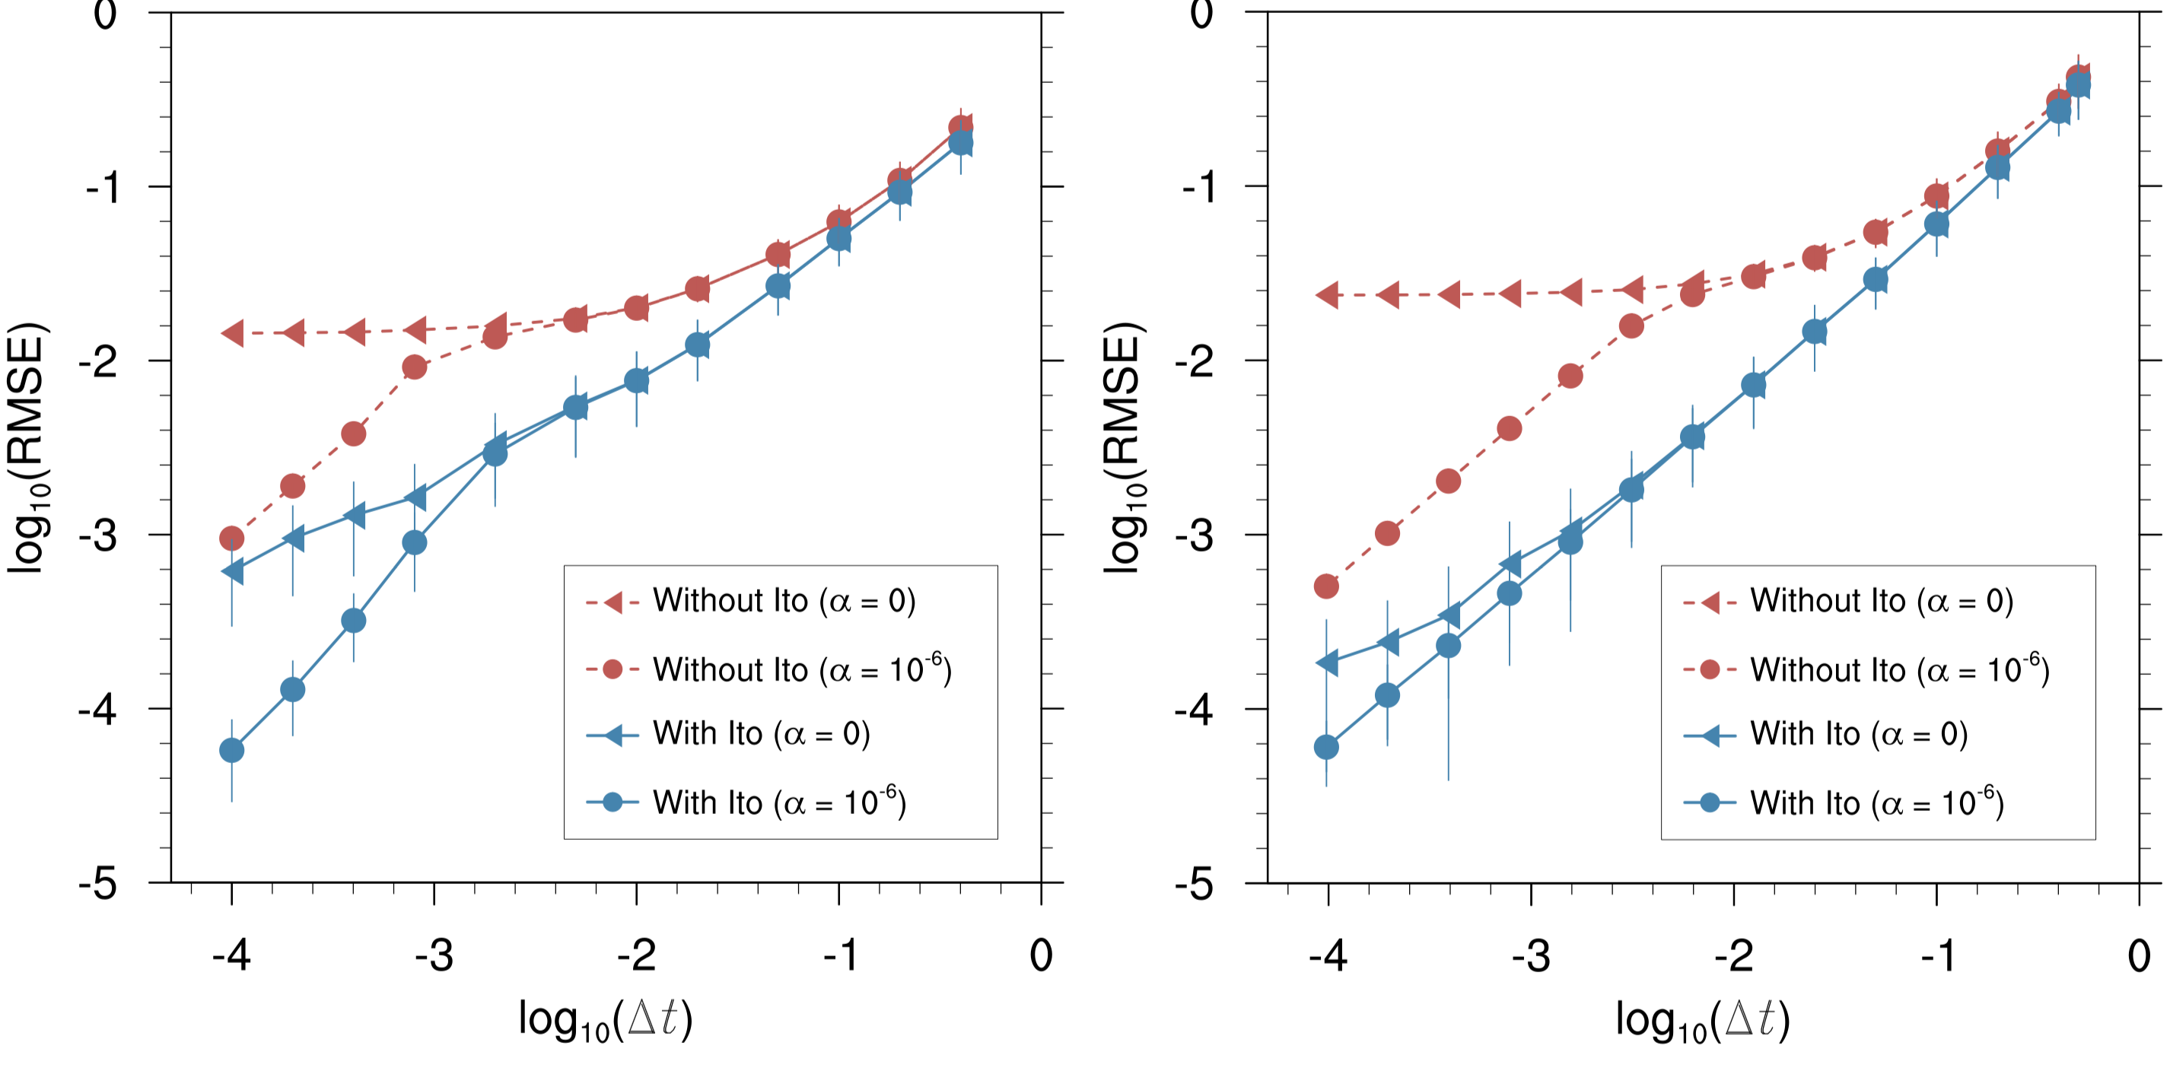
Improving Solution Accuracy and Convergence for Stochastic Physics Parameterizations with Colored Noise
Objective
Improve convergence of numerical simulations to the intended stochastic systems
Enhance the numerical accuracy and computational efficiency of the simulations
Approach
Clarify expected solution behavior using the theory of stochastic differential equations
Add an Itô correction to time stepping methods originally developed for deterministic systems to account for stochasticity
Derive a general formulation of the Itô correction for stochastic processes to account for both white and colored noise
Impact
Improved solution convergence and accuracy without requiring a complete redesign when introducing stochastic terms to legacy codes
Created a new, generalized Itô correction advantageous for weather and climate model development that is also applicable to a broad range of stochastic model equations
Numerical error in 1D advection-diffusion model solved without (red) or with (blue) Itô correction
Cases with constant coefficients
Cases with spatially-varying coefficients
When simulating phenomena featuring stochasticity, naively applying time stepping methods originally developed for deterministic problems can lead to large errors and loss of solution convergence. The inclusion of a new, generalized Itô correction term can substantially reduce solution error.
(𝛼 = 0: white noise. 𝛼 ≠ 0: colored noise.)
Stinis P, H Lei, J Li, and H Wan. 2020. “Improving Solution Accuracy and Convergence for Stochastic Physics Parameterizations with Colored Noise,” Monthly Weather Review, 148:2251-2263.
DOI: 10.1175/MWR-D-19-0178.1
Notes:
http://www.pnnl.gov/science/highlights/highlights.asp?division=749

