Slide 1
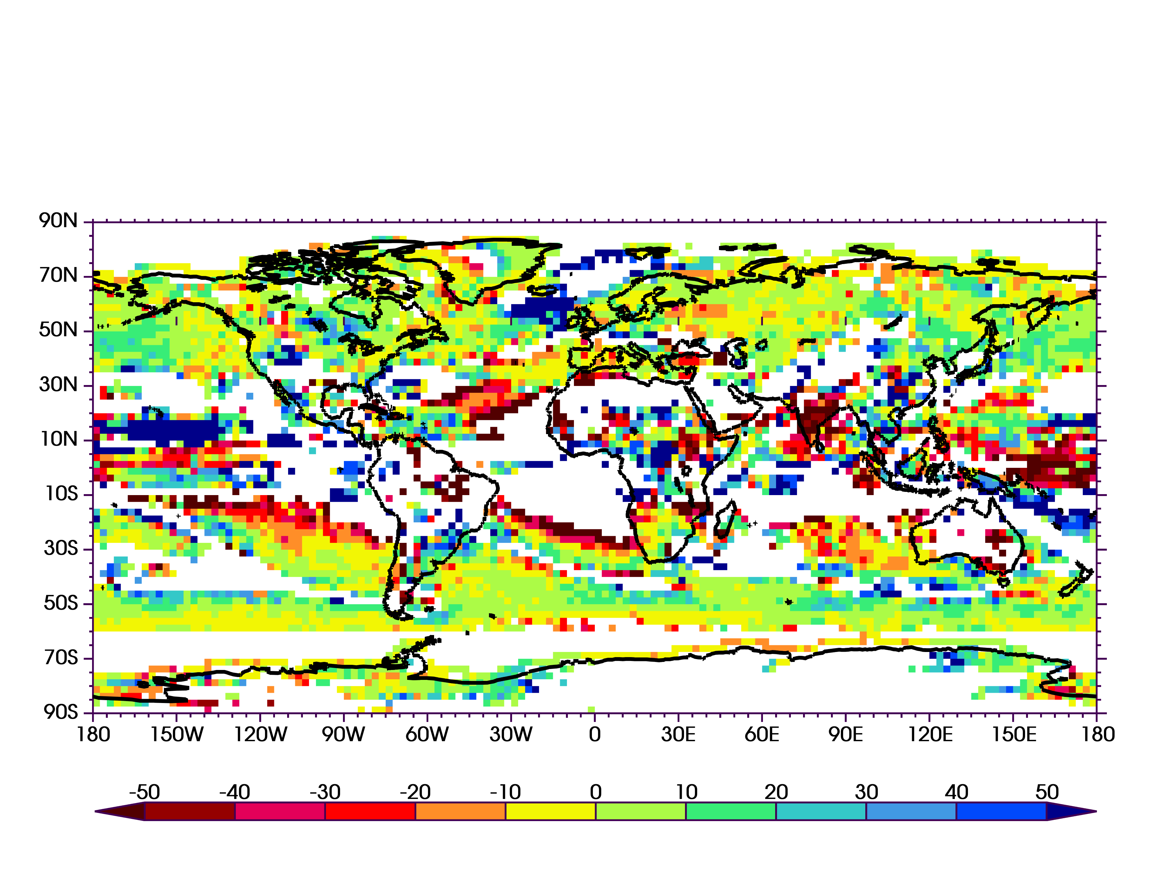
Model Quality Impacts Projections of Summer Rainfall
Objectives
Assess the impact of model quality and overconfidence on future projections of precipitation
Provide upper- and lower-bounds of the climate change projections
Approach
Intercompare Gaussian and non-parametric statistics for assessing statistical significance
Impact
Compared to using all CMIP5 models, sub-selecting models based on annual cycle fidelity results in differences between the two projections of up to ±50%
Even in regions where the PDF’s are highly skewed, Gaussian estimates of the upper- and lower-bounds of the climate change perturbations are consistent with non-parametric estimates
Annual Cycle subset – 33 models (% change)
Percent change in projection of summer precipitation due to sub-selection based on annual cycle fidelity compared to using all models.
Sperber, K. R., H. Annamalai, and G. Pallotta, “CMIP5: A Monte Carlo Assessment of Changes in Summertime Precipitation Characteristics Under RCP8.5-Sensitivity to Annual Cycle Fidelity, Overconfidence, and Gaussianity.” Climate Dynamics. (2020) [https://doi.org/10.1007/s00382-019-05082-8]
Notes:
K. R. Sperber and his colleagues evaluated summer precipitation characteristics using all available realizations from the CMIP5 Historical and RCP8.5 experiments. The novelty of this paper is that we generate probability distributions of yearly anomalies from each of the experiments for testing Gaussian vs. non-Gaussian statistics, the impact of over-confidence due to lack of model independence, and the impact of sub-selecting models based on the fidelity of the annual cycle of precipitation. The bottom line is that sub-selecting models based on annual cycle fidelity has a demonstrative impact on the magnitude of the projected change in precipitation amount (up to +/-50%), and that Gaussian statistics are a good proxy, even in cases in which the PDF’s are highly skewed. As such, we provide estimates of uncertainty in the projections by presenting the upper- and lower-bounds of the projected change for the 99% confidence interval.

