Slide 1
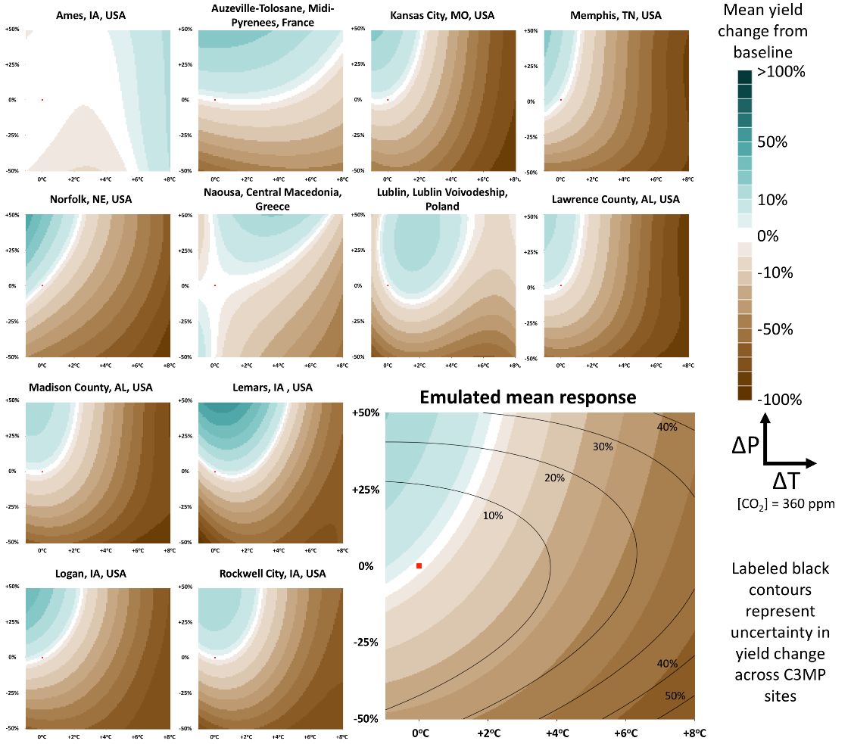
A Crop Yield Change Emulator for Use in GCAM and Similar Models: Persephone v1.0
Objective
Develop an emulator that requires less computation to estimate how crop yields change in response to arbitrary Earth system state fluctuations.
Approach
Use the Agricultural Model Intercomparison and Improvement Project (AgMIP) Coordinated Climate-Crop Modeling Project (C3MP) sensitivity test data set to estimate crop yield responses to changing Earth system state.
Employ a Bayesian approach to emulate the C3MP yield responses with quantification of crop response uncertainty.
Support this development with an open-source R package.
Impact
Persephone doesn’t need pre-computed Earth system inputs to estimate yield changes, allowing it to interact directly with GCAM to examine new, more complex questions.
Dynamic feedbacks among socioeconomics, Earth system fluctuations, and crop yield changes can now be explored.
A comparison of C3MP training site yield responses to changes in temperature and precipitation with fixed [CO₂] = 360 ppm for 12 representative rainfed maize sites located in the midlatitudes versus the emulated mean response for use in GCAM (bottom right corner). Similar responses are provided for a variety of crops, irrigation methods, and latitude bands across changes in temperature, precipitation, and [CO₂].
Snyder A, KV Calvin, M Phillips, and AC Ruane. 2019. “A Crop Yield Change Emulator for Use in GCAM and Similar Models: Persephone v1.0.” Geoscientific Model Development, 12:1319-1350. DOI:10.5194/gmd-12-1319-2019.
Notes:
http://www.pnnl.gov/science/highlights/highlights.asp?division=749

