Slide 1
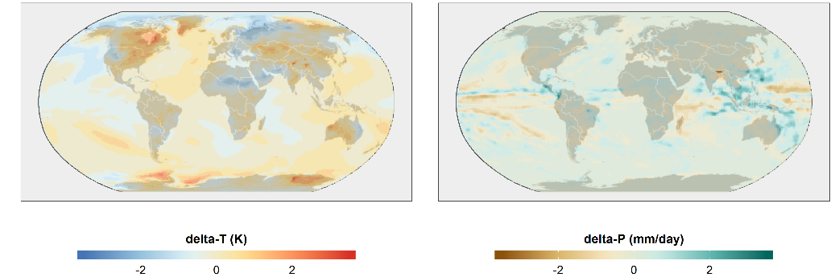
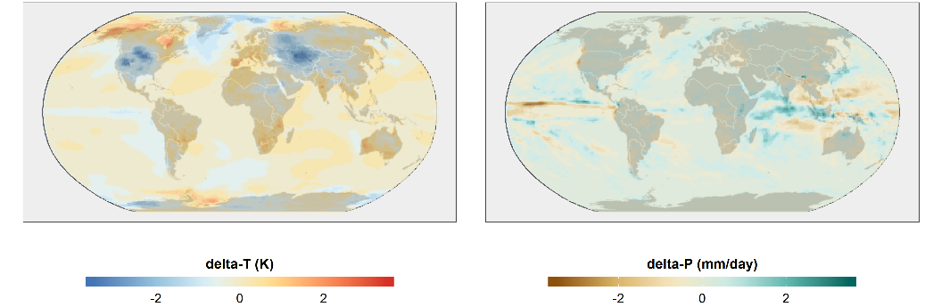
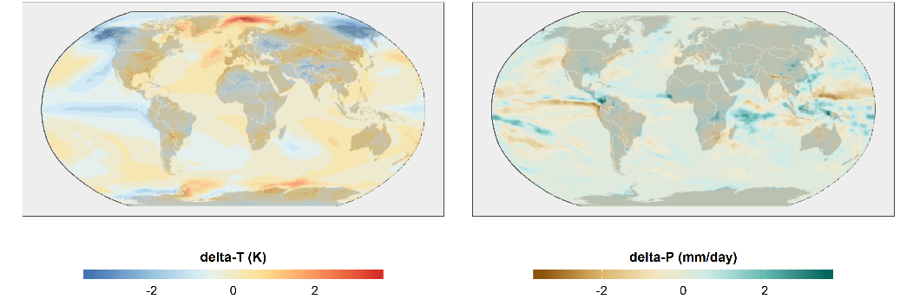
Rapidly Exploring Earth System Model Temperature and Precipitation Uncertainty
Objective
Rapidly produce and explore Earth system model (ESM) variables, including time and space, that computationally expensive EMSs can only produce if run thousands of times.
Approach
Decompose ESM temperature and precipitation data into space and time components, analyze these components, and generate new simulations of temperature and precipitation with the same statistical properties as the original ESM data.
Jointly produce temperature and precipitation realizations to generate thousands of simulations at once.
Impact
Created a way to study temperature and precipitation extremes more quickly and on more comprehensive scales than was previously available.
Developed method to inform studies that focus on preparing for and responding to extreme events.
PNNL’s fldgen v2.0 allows researchers to understand what temperature and precipitation scenarios an ESM could have produced if it had been run thousands of times.
Snyder A, Link R, Dorheim K, Kravitz B, Bond-Lamberty B, and Hartin C. 2019. “Joint Emulation of Earth System Model Temperature-Precipitation Realizations with Internal Variability and Space-Time and Cross-Variable Correlation: fldgen v2.0 software description,” PLOS ONE, 14(10): e0223542. https://doi.org/10.1371/journal.pone.0223542.
Notes:
http://www.pnnl.gov/science/highlights/highlights.asp?division=749

