Slide 1


Predicting near-term globally averaged temperature
Objective: Quantify the time-evolution of near-term globally averaged temperature using initialized predictions with a suite of global coupled earth system models
Research:
--Analyze initialized decadal predictions with a suite of global coupled earth system models
--the initialized predictions take into account the observed present day conditions since this is essential to predict the evolution of natural variability.
Predicted chance of temporarily exceeding 1.5 °C warming above preindustrial conditions. Time series of rolling 5-year average global mean surface temperature relative to preindustrial (left axis) in observations (black) compared to initialized forecasts (red, solid line showing the ensemble mean and shading the 5–95% ensemble range) and uninitialized simulations (blue, solid line showing the ensemble mean and shading the 5–95% ensemble range). The date represents the start of each 5-year forecast.
Impact: For the period 2017 to 2021 we predict a 38% and 10% chance, respectively, of monthly or yearly temperatures exceeding 1.5 °C, with virtually no chance of the 5-year mean being above the threshold.
Smith, D., G.A. Meehl and co-authors, 2018: Predicted chance that global warming will temporarily exceed 1.5˚C, Geophys. Res. Lett., DOI: 10.1029/2018GL079362.

Slide 2
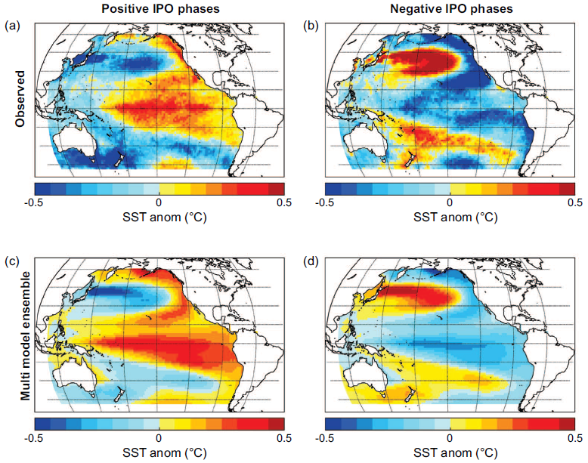
Earth system models can successfully simulate a major mode of decadal variability, the Interdecadal Pacific Oscillation (IPO)
Objective: Explore how well current Earth System Models simulate a major mode of internally generated, naturally-occurring decadal earth system variability, the Interdecadal Pacific Oscillation (IPO)
Research:
--Analyze the CMIP5 multi-model ensemble to document the models’ capability to simulate the IPO
--Compare model results to observations, and quantify agreement
Spatial IPO patterns show good agreement between models and observations. Observed IPO spatial patterns in (a) IPO positive and (b) IPO negative phases; Multi-model pre-industrial control mean spatial patterns of IPO in (c) IPO positive and (d) IPO negative
Impact: A systematic evaluation of the simulation of the IPO in the suite of Coupled Model Intercomparison Project 5 (CMIP5) models shows that the Pacific basin-wide spatial pattern of positive and negative phases of the IPO are simulated reasonably well, thus building confidence in initialized decadal climate simulations that include the IPO
Henley, B.J., G.A. Meehl, S.B. Power, C.K. Folland, A.D. King, J.N. Brown, D.J. Karoly, F. Delage, A.J.E. Gallant, M. Freund, and R. Neukom, 2017: Spatial and temporal agreement in climate model simulations of the Interdecadal Pacific Oscillation, Env. Res. Lett., 12, 044011.

