Slide 1
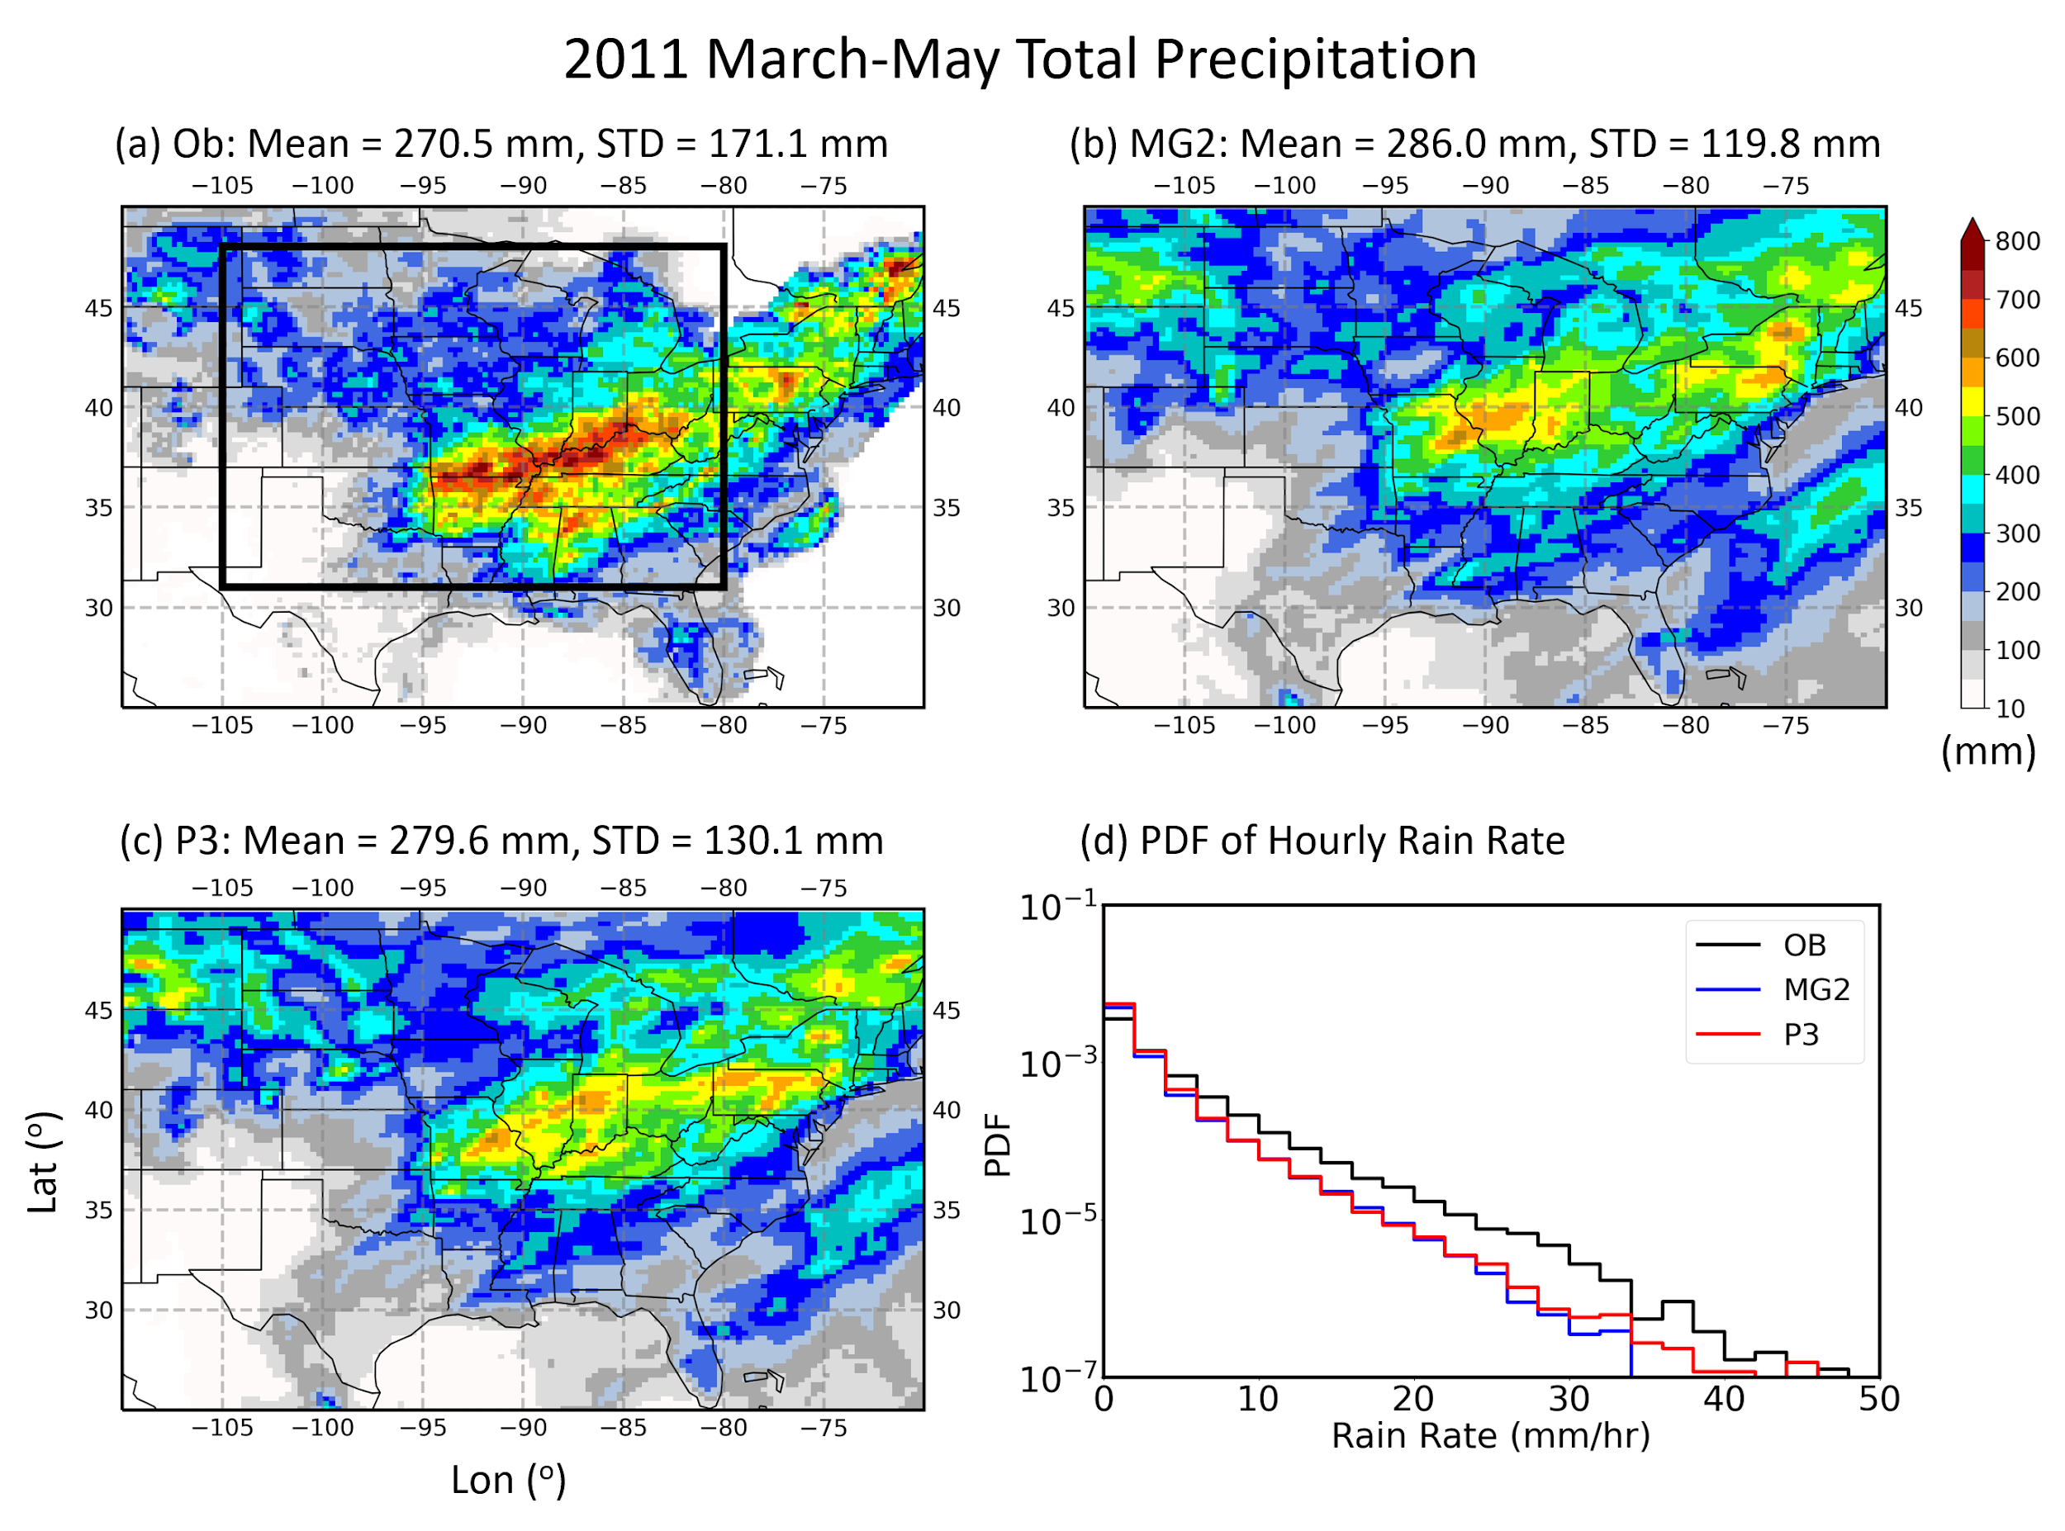
New Cloud Microphysics Improves Simulation of Mesoscale Convective Systems
Objective
Evaluate the performance of the newly developed Predicted Particle Properties (P3) microphysics scheme in the Energy Exascale Earth System Model (E3SM) for simulating mesoscale convective systems (MCSs) in the regionally refined model (RRM) framework.
Approach
Modify P3, originally developed for high-resolution weather models, for incorporation into E3SM.
Conduct RRM simulations at 0.25° over the contiguous United States using P3 and compare the results with the original microphysics scheme, MG2.
Impact
The new microphysics scheme employed in E3SM improves the simulation of precipitation and the frequency distribution of precipitation rates.
P3 notably improves the simulation of MCS number and precipitation by predicting higher frequencies of large precipitation rates.
The improvements mainly result from better representations of ice microphysics, which produces higher rain rates through melting and larger latent heating.
Frequency distribution of hourly precipitation rates from observation (black), the original E3SM scheme MG2 (blue), and the new scheme P3 (red). P3 predicts more frequent occurrence of large rain rates than MG2, in better agreement with observations.
Wang J, J Fan, Z Feng, K Zhang, et al. 2021. “Impact of a new cloud microphysics parameterization on the simulations of mesoscale convective systems in E3SM.” Journal of Advances in Modeling Earth Systems, 13: e2021MS002628, DOI:10.1029/2021MS002628.
Notes:
http://www.pnnl.gov/science/highlights/highlights.asp?division=749

