Slide 1
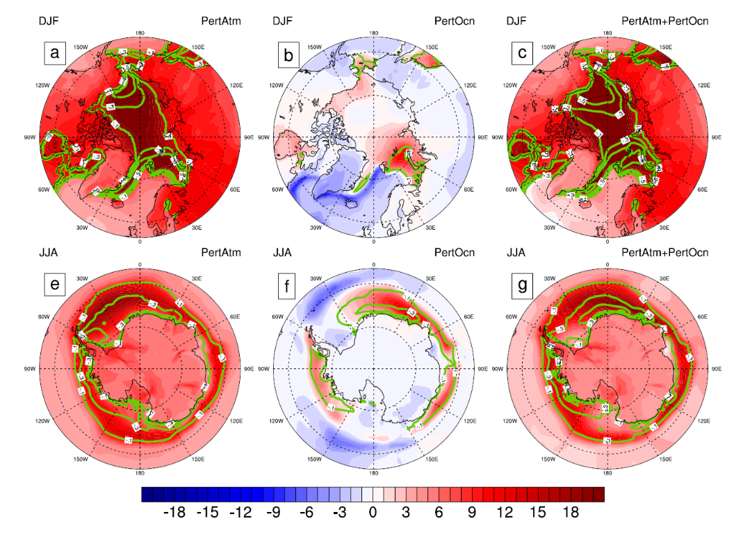
Increased Ocean Heat Convergence Into the High Latitudes With CO₂ Doubling Enhances Polar-Amplified Warming
Objective
Highlight the roles played by the atmosphere and ocean in transporting heat from lower latitudes to the poles that leads to a polar amplification of the planet’s temperature changes
Approach
Use a coupled atmosphere slab ocean model to isolate the relative importance of ocean and atmospheric heat transports in environmental change at high latitudes
Impact
Polar warming connected with a range of impacts, including polar ice cap loss, global sea level rise, mid-latitude weather extremes, and reduced oceanic biological productivity
This study provides insight into the relative importance of the atmosphere and ocean in high-latitude warming. Large-scale ocean dynamics appears to be of secondary importance in causing polar amplification, but the energy that is transported by the ocean is more effective in driving polar amplification than energy transported by the atmosphere. There is a fundamental asymmetry in how these energy transports warm high latitudes.
Changes in surface temperature (colors; in K) and sea ice concentration (contours at −0.1, −0.3, −0.5, −0.7, −0.9) in winter due to changing atmosphere and ocean heat transports. Upper row shows Northern Hemisphere winter and lower row shows Southern Hemisphere winter: Left panels indicate changes from CO₂ forcing, middle panels from ocean heat transports, and right panels from their combination.
Singh HA, PJ Rasch, and BEJ Rose. 2017. “Increased Ocean Heat Convergence Into the High Latitudes With CO₂ Doubling Enhances Polar-Amplified Warming.” Geophysical Research Letters 44:10,583-10,591. DOI: 10.1002/2017GL074561
Notes:
http://www.pnnl.gov/science/highlights/highlights.asp?division=749

