Slide 1
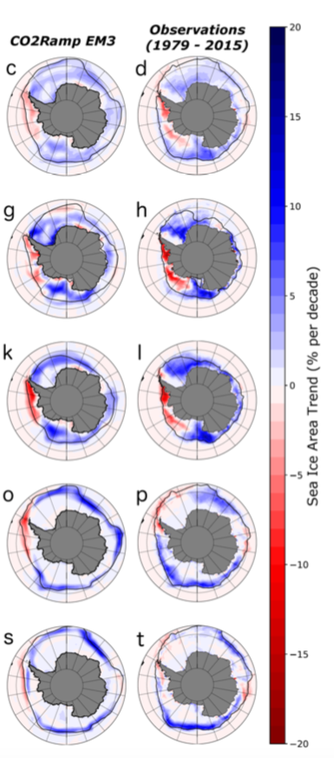
Natural Variability of Antarctic Sea Ice Can Obscure Changes due to CO₂ and Surface Temperature Increases
Annual
Objective
Explain observed (1979-2015) sea ice increases near Antarctica that occurred despite global CO₂ and temperature increases.
Examine the relative importance to sea-ice change due to Earth’s internal variability and warming by greenhouse gases.
Approach
Create a collection of ocean-to-atmosphere states known to produce rapid ice growth in long simulations run with pre-industrial CO₂ concentrations (due to natural variability)
Rerun those simulations in the presence of increasing CO₂ to see whether Antarctic sea ice extent still grows (for a few decades) in spite of the global warming.
Impact
Established that natural variability in the climate system around Antarctica can be so large that it can (sometimes and temporarily) overwhelm the signal from greenhouse gas increases.
CO₂ warming impacts eventually overcome natural variations in the system near Antarctica leading to decreases in sea ice.
Dec-Feb
Mar-May
June-Aug
Sep-Nov
Regional increasing sea-ice area trends are shown with a model simulation experiencing global warming (left) compared to observed sea ice increases (right).
Singh, H. A., Polvani, L. M., & Rasch, P. J.. (2019). Antarctic sea ice expansion, driven by internal variability, in the presence of increasing atmospheric CO2. Geophysical Research Letters, 46.
https://doi.org/10.1029/2019GL083758

