Slide 1
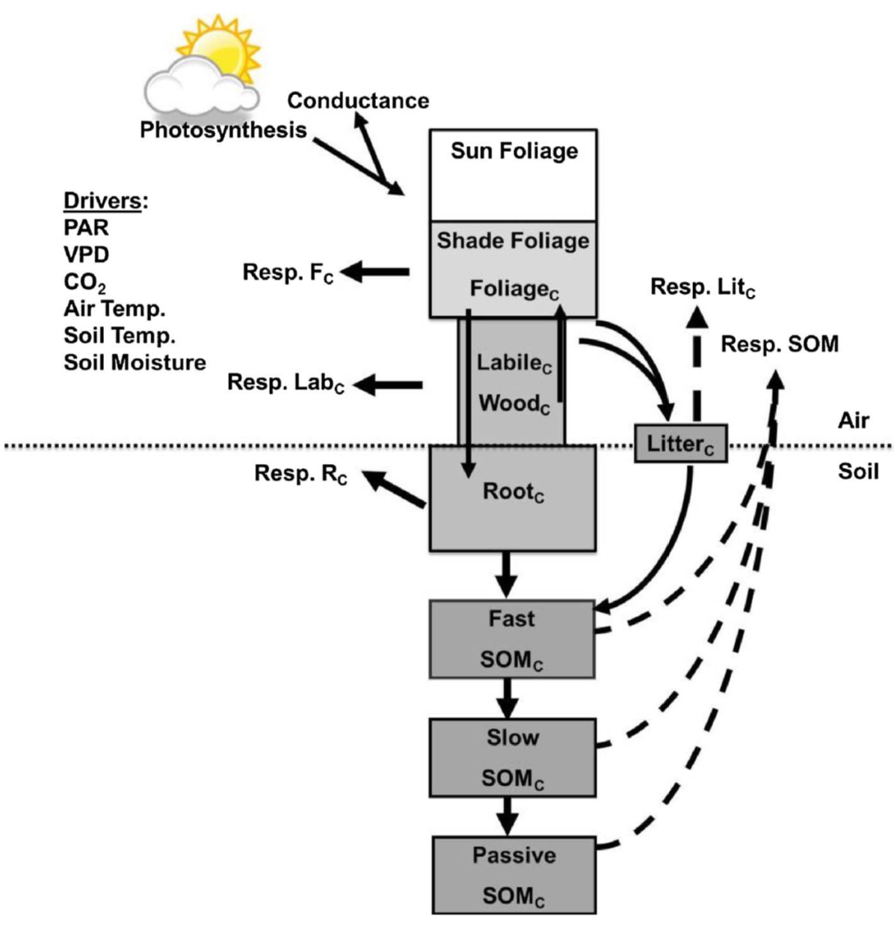
Merging a mechanistic enzymatic model of soil heterotrophic respiration into an ecosystem model in two AmeriFlux sites of northeastern USA
Scientific Achievement
Explicit representation of substrate supply
Improved performance of ecosystem models and ESMs.
Responses to drought more effectively captured
Significance and Impact
Drought impacts on forest carbon cycling are critical for global predictions of the terrestrial C cycle
We examine the implications of an improved representation of the pathways of drought influence
We showed that current biases can be reduced though improved process representation
Figure. Carbon flows through multiple compartments in the DAMM-FöBAAR forest ecosystem model.
Research Details
Sihi, D., Davidson., E., Chen, M., Savage, K., Richardson, A., Keenan, T., Hollinger, D., Merging a mechanistic enzymatic model of soil heterotrophic respiration T into an ecosystem model in two AmeriFlux sites of northeastern USA, Agricultural and Forest Meteorology 252 (2018) 155–166, doi:10.1016/j.agrformet.2018.01.026
We combined multiple years of eddy-covariance and ancillary measurements at two eastern temperate forests with a parsimonious process-based model of the terrestrial carbon cycle to assess the impact of drought on forest ecosystem respiration.

