Slide 1
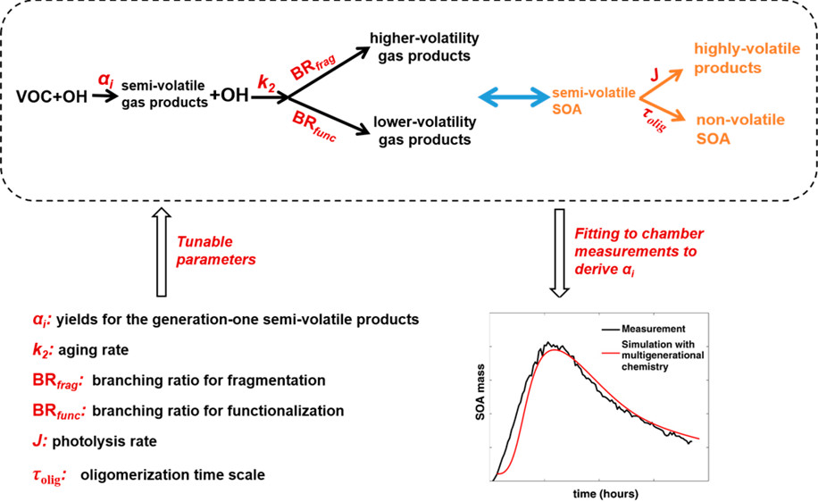
New Empirical Yields of Isoprene Secondary Organic Aerosol Explicitly Including Processes
Objective
Develop a new empirical box modeling framework that derives isoprene secondary organic aerosol (SOA) yields while explicitly accounting for dynamic SOA processes during fitting
Approach
Derive new empirical parameters to represent (1) the dynamic evolution of SOAs in smog chambers as a function of NO_{x}-dependent multigenerational chemistry and (2) losses of gases and particles to walls
Impact
While SOA chemistry processes are complex, researchers demonstrated a new, empirical way to parameterize SOA evolution observed in smog chambers
Results showed that SOA yields change as a function of processes included during fitting of yields
Most previous approaches do not explicitly include SOA dynamic processes during fitting of SOA yields
The new approach will provide much better representation of dynamic SOA processes in the atmosphere and improve the predictive ability of 3D chemical transport models
The new empirical box modeling approach shows that just a few tunable parameters could represent the complex chemistry and dynamic SOA evolution observed in smog chambers. In the future, this framework could include more SOA processes and be used to ultimately bridge the gap between measurements and model predictions of SOAs.
Xing L, M Shrivastava, T-M Fu, P Roldin, Y Qian, L Xu, NL Ng, J Shilling, A Zelenyuk, and CD Cappa. 2018. “Parameterized Yields of Semivolatile Products from Isoprene Oxidation under Different NO_{x} Levels: Impacts of Chemical Aging and Wall-Loss of Reactive Gases. Environmental Science & Technology, 52(16):9225-9234. DOI: 10.1021/acs.est.8b00373
Notes:
http://www.pnnl.gov/science/highlights/highlights.asp?division=749

