Slide 1
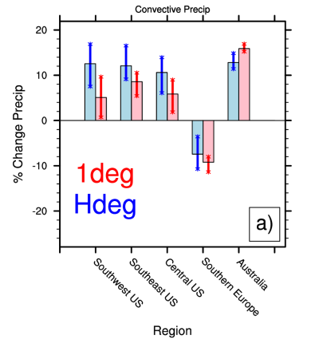

Climate Change Signals for Regional Precipitation using High Resolution CCSM4
Objective
Integrate high resolution CCSM4 fully coupled(50km in the atmosphere/land) for long historical and climate change ensemble simulations.
Analyze precipitation for agriculturally sensitive regions and monsoon areas that are shown to improve with higher resolution.
Evaluate precipitation sensitivity to increased horizontal resolution.
Shown are the 95th percentile the wettest days climate change signals (RCP8.5-20th) for the agricultural regions.
Southwest U.S. climate change is generally wetter in the Hdeg vs the 1deg, and for the large-scale precipitation, the climate change signal changes sign. Southern Europe exhibits a clear drying signal.
Approach
Separate precipitation into convective versus large scale components
Analyze both mean and extreme precipitation
Compare with standard 1 degree CCSM4 ensemble suite
Validate historical 20th Century simulations and analyze RCP8.5 simulations
Characterize climate change for: North American and South Asian monsoons, Southwest, Central, and Southeast U.S., Southern Europe, Australia.
Impact
Generally, mean convective (large-scale) precipitation decreases (increases) with increased model resolution and can explain many differences in the climate change signal between high and standard resolution models.
Improvements in the half-degree CCSM4 compared to the standard resolution are also linked to finer topographical details in areas of complex terrain.
Higher resolution CCSM4 improves the extreme precipitation simulation.
Shields, C.A., J.T. Kiehl, and G.A. Meehl, 2016: Future Changes in Regional Precipitation Simulated by a Half-Degree Coupled Climate Model: Sensitivity to Horizontal Resolution, JAMES, in press.

