Slide 1
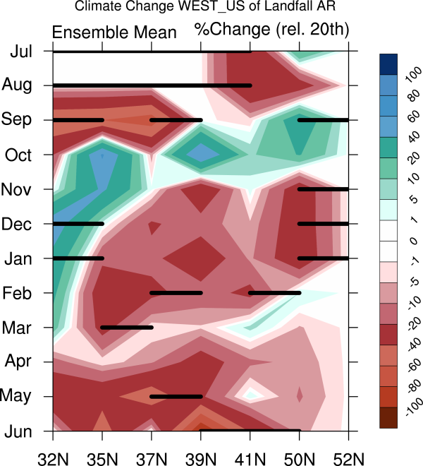
Atmospheric River Landfall-Latitude Changes in Future Climate Simulations
Objective
Compare changes in latitude of landfall for U.S. West Coast (North Pacific) atmospheric rivers (ARs) versus UK (North Atlantic) ARs in future climate simulations
Determine role of jetstream simulated in future climate changes
Hovmueller diagram of AR frequency percent climate change (RCP8.5-historical/historical) seasonal cycle versus latitude of landfall for the U.S. West Coast. Black bars denote significance. Ensemble means are plotted. AR frequency changes in both Western U.S. and UK track with the jetstream changes.
Approach
Analyze high resolution model data to more finely identify AR landfall-latitude
Use high frequency output (6-hourly data) from the CCSM4 Half degree ensemble suite of simulations, which include historical and RCP8.5 future climate scenarios.
Use AR detection algorithm defined in Shields and Kiehl ,GRL 2016.
Identify dynamical difference based on subtropical versus eddy-resolved jets.
Impact
Hdeg CCSM4 projects more land-falling winter ARs for Southern California under the RCP8.5 scenario due to influences from the subtropical jet.
Landfall changes in ARs affecting UK are projected to be seasonally dependent and influenced primarily by eddy-driven jets.
Causality of future changes to AR landfall location differs dynamically between Pacific and Atlantic ARs.
Shields, C.A. and J.T.Kiehl, 2016: Atmospheric River Landfall-Latitude Changes in Future Climate Simulations, GRL, in press.

