Slide 1
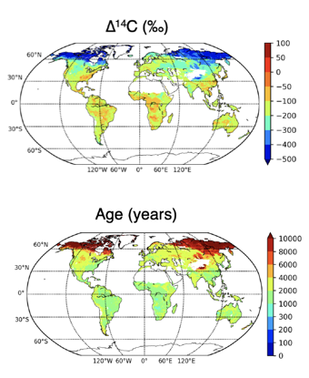
New global maps of soil radiocarbon and carbon mean age indicate turnover is too rapid in models
Objective: To determine global distribution of soil radiocarbon and carbon age, and use them to evaluate models
Approach: Use machine learning to scale up hundreds of soil radiocarbon profiles, along with other geospatial information
Results/Impacts: Global soil carbon down to one meter has a mean age of nearly 5,000 years, with older carbon in deeper layers and permafrost regions. In contrast, vertically resolved land models simulate younger carbon ages and more rapid carbon turnover. Our estimates suggest that soils will accumulate less carbon than predicted by current Earth system models over the 21st century.
Figure: Global maps of soil radiocarbon and mean carbon age
Shi, Zheng, S. D. Allison, Y. He, Paul A. Levine, A. M. Hoyt, J. Beem-Miller, Qing Zhu, W. R. Wieder, S. E. Trumbore, and James T. Randerson (2020), The age distribution of global soil carbon inferred from radiocarbon measurements, Nat. Geosci., doi:10.1038/s41561-020-0596-z.

