Slide 1
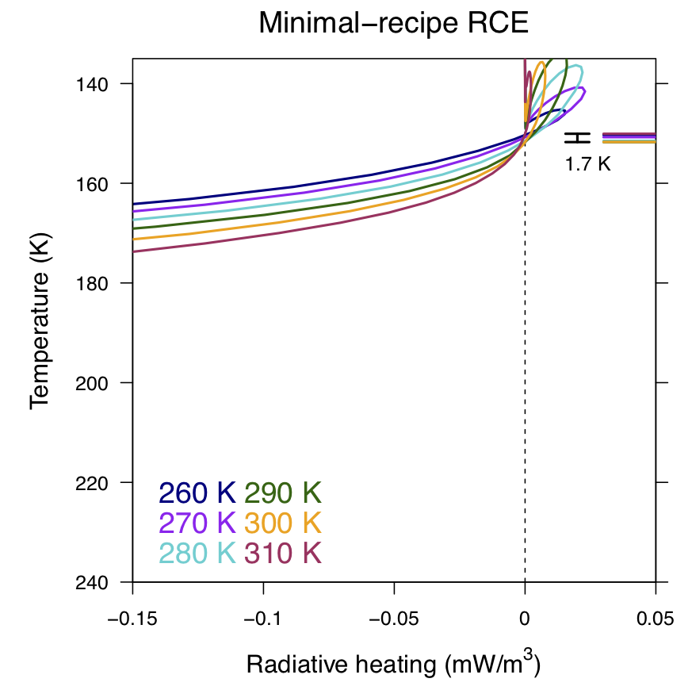
FAT or FiTT: Are anvil clouds or the tropopause temperature-invariant?
The Fixed Anvil Temperature (FAT) hypothesis is tested with simulations of radiative-convective equilibrium (RCE) in a model with only the basic physics claimed to lead to FAT. It is found that FAT is violated. Instead of FAT, a Fixed Tropopause Temperature (FiTT) is found.
Tropical anvil clouds play a large role in Earth's radiation balance, so it is important to learn what sets the anvil temperature. This work suggests that a first step in that direction would be to understand what sets the invariant temperature of the overlying tropopause.
For a 50-K range in SST (260 K to 310 K), cloud resolving simulations of RCE produce a change in tropopause temperature that is less than 2 K.
A Fixed Anvil Temperature (FAT) does not result from temperature-dependent longwave radiative emission from water vapor
Simulations of radiative-convective equilibrium without a FAT still have a Fixed Tropopause Temperature (FiTT)
A FiTT does not imply a FAT because anvil clouds are not produced by enhanced detrainment below the tropopause
Citation: J.T. Seeley, N. Jeevanjee, and D.M. Romps, “FAT or FiTT: Are anvil clouds or the tropopause temperature-invariant,” Geophysical Research Letters, in press, 2019

