Slide 1
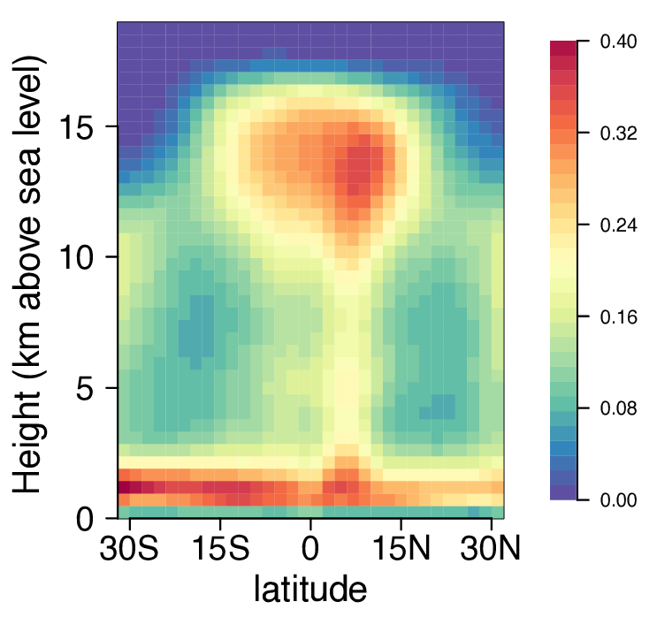
Formation of tropical anvil clouds by slow evaporation
In the tropics, the highest cloudiness occurs in the upper troposphere. This paper disproves the conventional paradigm for this phenomena, and shows that, instead, the correct explanation is that condensates evaporate very slowly in the cold upper troposphere.
How will the distribution of high tropical clouds alter with global warming, and what feedback will that produce? It is impossible to know the answer to these questions without knowing why those clouds are there in the first place. A parameterization of cloudiness for GCMs is proposed.
Cloud fraction from colocated spaceborne radar (CloudSat) and lidar (Cloud-Aerosol LIdar with Orthogonal Polarization; CALIOP) as described in Kay and Gettelman (2009) averaged over July 2006 to February 2011 and plotted as a function of latitude and altitude, zonally averaged.
The sources and sinks of cloudy air are quantified and manipulated in cloud-resolving simulations of radiative-convective equilibrium.
The cloud-fraction peak associated with anvil clouds is found to result from the long lifetime of cloud condensates in the upper troposphere.
Cloud lifetimes are long in the upper troposphere due to the slow evaporation of cloud condensates at cold temperatures.
Citation: J.T. Seeley, N. Jeevanjee, W. Langhans, and D.M. Romps, “Formation of tropical anvil clouds by slow evaporation,” Geophysical Research Letters, in press, 2019

