Slide 1
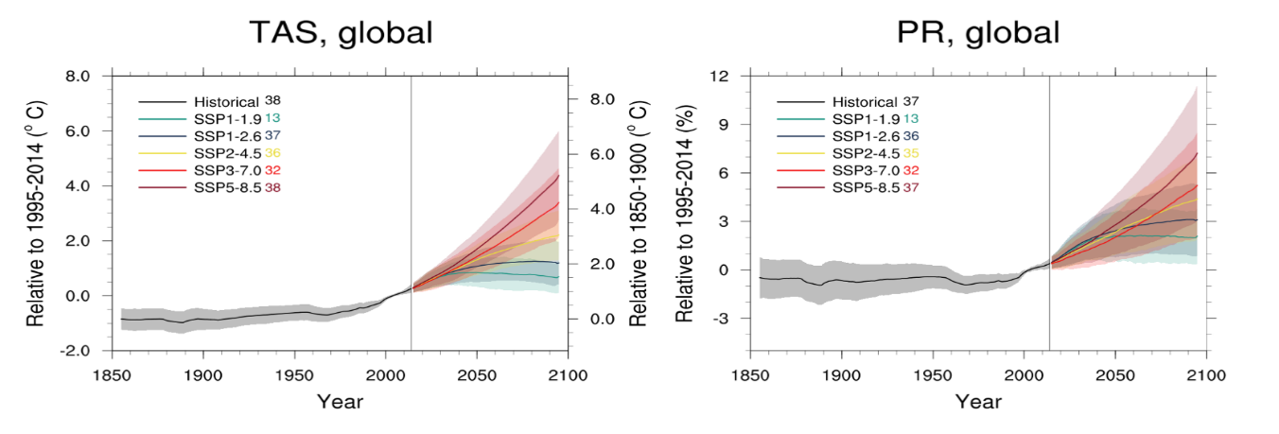
The Latest 21st Century Projections of Temperature and Precipitation Changes
Objective
Present an overview of some major results from the new coordinated Coupled Model Intercomparison Project (CMIP) phase 6/ScenarioMIP effort, which provides the research community with the main source of future climate projections, according to the new Shared Socio-economic Pathways- (SSP-) based scenarios.
Approach
Describe average temperature and precipitation projections for a wide range of scenarios, at a global mean scale or as spatial patterns.
Compare with the corresponding Representative Concentration Pathway-based CMIP5 results to highlight sources of commonalities and differences.
Analyze aspects of signal emergence, scenario separation, internal variability, threshold crossing, and reversibility.
Impact
This paper will provide a reference for and context to a multitude of more in depth and specific analyses based on the results of CMIP6 ScenarioMIP in the physical climate change domain and the impact and mitigation research communities.
The paper explicitly recognizes the participation efforts of about 40 modeling groups (including the Energy Exascale Earth System Model).
Temperature and precipitation projections under the new Shared Socioeconomic Pathway-RCP scenarios and from the new CMIP6 models participating in ScenarioMIP.
C. Tebaldi, et al. “Climate model projections from the Scenario Model Intercomparison Project (ScenarioMIP) of CMIP6”, Earth Syst. Dynam., 12, 253–293, (2021).https://doi.org/10.5194/esd-12-253-2021.
Notes:
C. Tebaldi, K. Debeire, V. Eyring, E. Fischer, J. Fyfe, P. Friedlingstein, R. Knutti, J. Lowe, B. O'Neill, B. Sanderson, D. van Vuuren, K. Riahi, M. Meinshausen, Z. Nicholls, K. B. Tokarska, G. Hurtt, E. Kriegler, J.-F. Lamarque, G. Meehl, R. Moss, S. E. Bauer, O. Boucher, V. Brovkin, Y.-H. Byun, M. Dix, S. Gualdi, H. Guo, J. G. John, S. Kharin, Y. Kim, T. Koshiro, L. Ma, D. Olivié, S. Panickal, F. Qiao, X. Rong, N. Rosenbloom, M. Schupfner, R. Séférian, A. Sellar, T. Semmler, X. Shi, Z. Song, C. Steger, R. Stouffer, N. Swart, K. Tachiiri, Q. Tang, H. Tatebe, A. Voldoire, E. Volodin, K. Wyser, X. Xin, S. Yang, Y. Yu, and T. Ziehn. “Climate model projections from the Scenario Model Intercomparison Project (ScenarioMIP) of CMIP6.” Earth Syst. Dynam., 12, 253–293, (2021). https://doi.org/10.5194/esd-12-253-2021.

