Slide 1
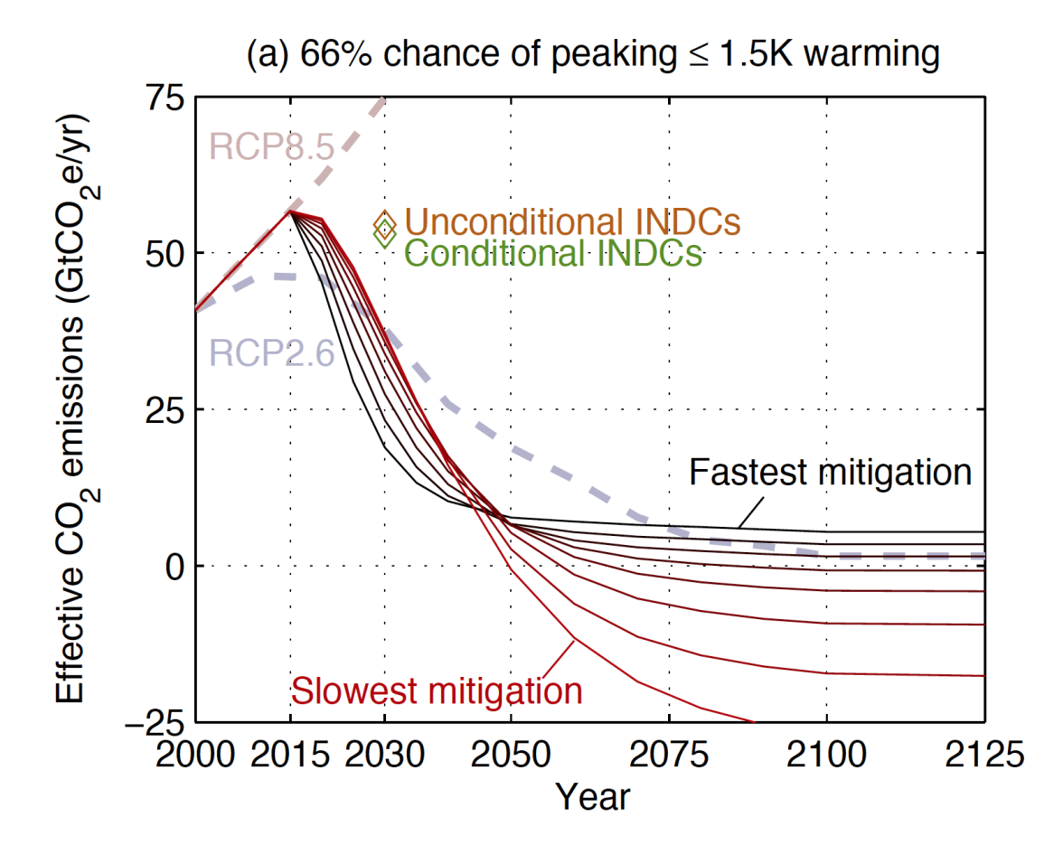
What would it take to achieve the Paris temperature targets?
Motivation
Determine quantitative estimates for the family of emissions scenarios which would be compatible with the 1.5 and 2 degree warming targets laid out in the 2015 Paris Agreements
Results
2030 emissions in line with INDCs are unlikely to avoid 2 degrees warming
Small increases in near-term mitigation allow large reductions in negative emissions later
A 50 year overshoot of 1.5 degrees requires net zero emissions by 2060
Impact
Emissions targets in the Paris agreement will need to be strengthened in order to achieve temperature targets
These pathways will be used to drive ESM simulations which can inform the IPCC 1.5 degree report
Sanderson, B.M., O'Neill B.C. and Tebaldi, C., What would it take to achieve the Paris temperature targets? Geophysical Research Letters, in press

