Slide 1
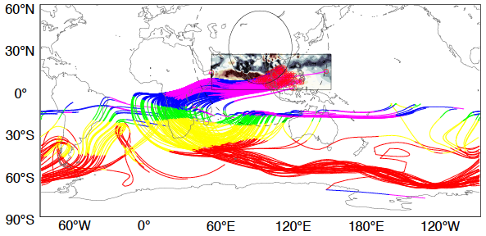
Deciphering the Pathways from Convection to Jet Stream in a Global Variable-Resolution Model
Objective
Understand how changes in convection at regional-scale influence the jet stream at global scale (upscale effect) and determine its consistency in variable-resolution and globally high-resolution simulations
Approach
Analyze a set of Model for Prediction Across Scale (MPAS-A) simulations, including two global quasi-uniform resolution simulations and three global variable-resolution simulations with a regional refinement in the United States, South America, and Asia
Apply several dynamical diagnostics, including a recently developed large-scale wave theory, to determine the mechanistic pathways of the upscale effect on the Southern Hemisphere jet
Wave trajectories from the high-resolution Asian Monsoon region in an MPAS-A variable-resolution simulation
Impact
First study enumerating the large-scale wave dynamics of upscale effects simulated by a variable-resolution model
Demonstrated consistency of the upscale effect between the variable-resolution and globally high-resolution simulations
Provided evidence that local-scale improvement can be translated to large-scale and remote climate by the variable-resolution MPAS-A at a lower computational cost compared to global high-resolution modeling
Sakaguchi K, J Lu, LR Leung, C Zhao, Y Li, and S Hagos. 2016. “Sources and pathways of the upscale effects on the Southern Hemisphere jet in MPAS-CAM4 variable-resolution simulations.” Journal of Advances in Modeling Earth Systems, 8, doi:10.1002/2016MS000743.

