Slide 1
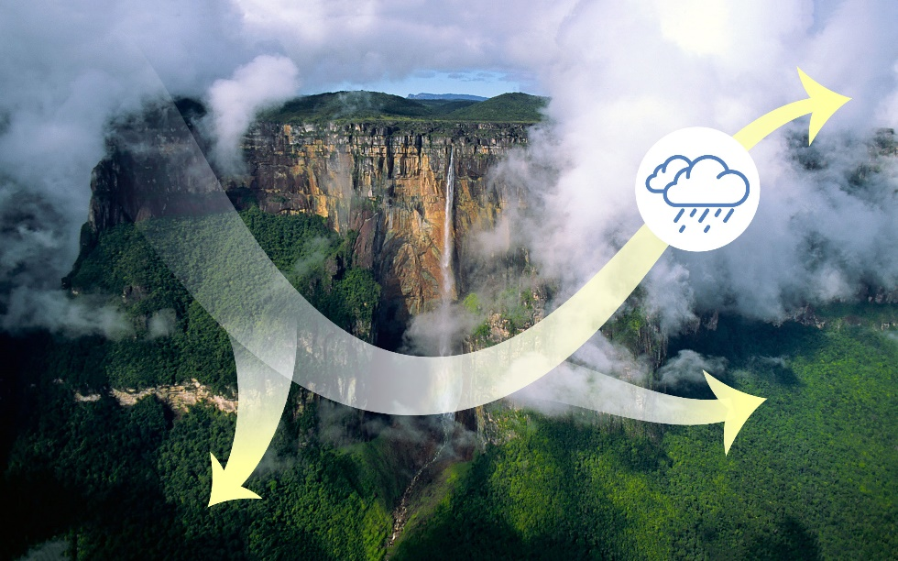
Restoring Rain to a Model Amazon Forest
Objective
Understand why a climate model does not simulate enough precipitation over the Amazon forest
Approach
Systematically evaluate more than 20 different global simulations from a climate model
Analyze how mountains, coastlines, clouds, and atmosphere interact with each other in the Amazon in the model and observations
Test different ways for convective clouds to respond to the atmospheric moisture and temperature changes in the model
Impact
The Amazon forest plays a significant role in the global-scale water and carbon cycles, and simulating a realistic rainfall amount for the Amazon is a prerequisite for reliable climate projection
Wind interactions with the underlying surface and convective clouds are revealed as the processes responsible for the model dry bias
This study provides important insights for how to improve the modeling of Amazon rainfall
The complex topography of the Amazon and its coastlines affect airflow near the surface, deflecting winds that, in turn, control where water vapor converges to produce clouds and rain.
Sakaguchi K, LR Leung, CD Burleyson, H Xiao, and H Wan. 2018. “Role of Troposphere-Convection-Land Coupling in the Southwestern Amazon Precipitation Bias of the Community Earth System Model Version 1 (CESM1),” Journal of Geophysical Research: Atmospheres, 123:8374-8399. DOI: 10.1029/2018JD028999

